Slide 1

SYZYGY PLASMONICS OVERVIEW FOR DECARB CONNECT
CHIEF EXECUTIVE OFFICER, CO-FOUNDER:
TREVOR BEST
CHIEF TECHNOLOGY OFFICER, CO-FOUNDER:
SUMAN KHATIWADA
CHIEF FINANCIAL OFFICER:
BENJAMIN SMITH
CHIEF COMMERCIAL OFFICER:
FREDERYK NGANTUNG

Slide 2




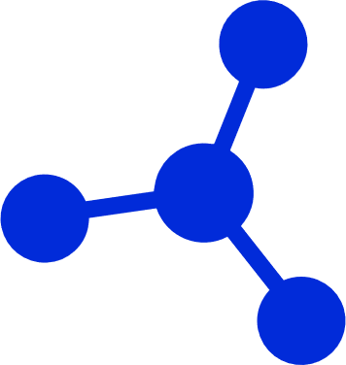
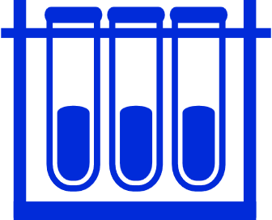
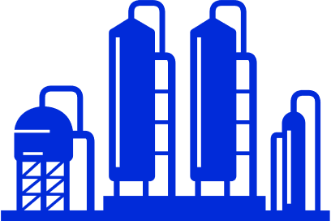
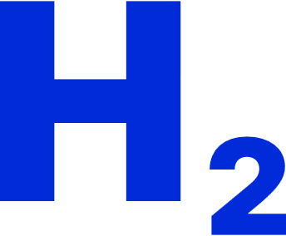





The >$1 Trillion Chemical Value Chain
Forms a Foundation for Modern Society
RAW MATERIALS
Petroleum
Natural Gas
Air
CHEMICAL VALUE CHAIN
Hydrogen
Methanol
Ammonia
Aromatics
Olefins
FINAL PRODUCTS
Fuels & Fertilizer
Textiles
Automobile Parts
Construction Materials
Medicine & Cosmetics

Slide 3

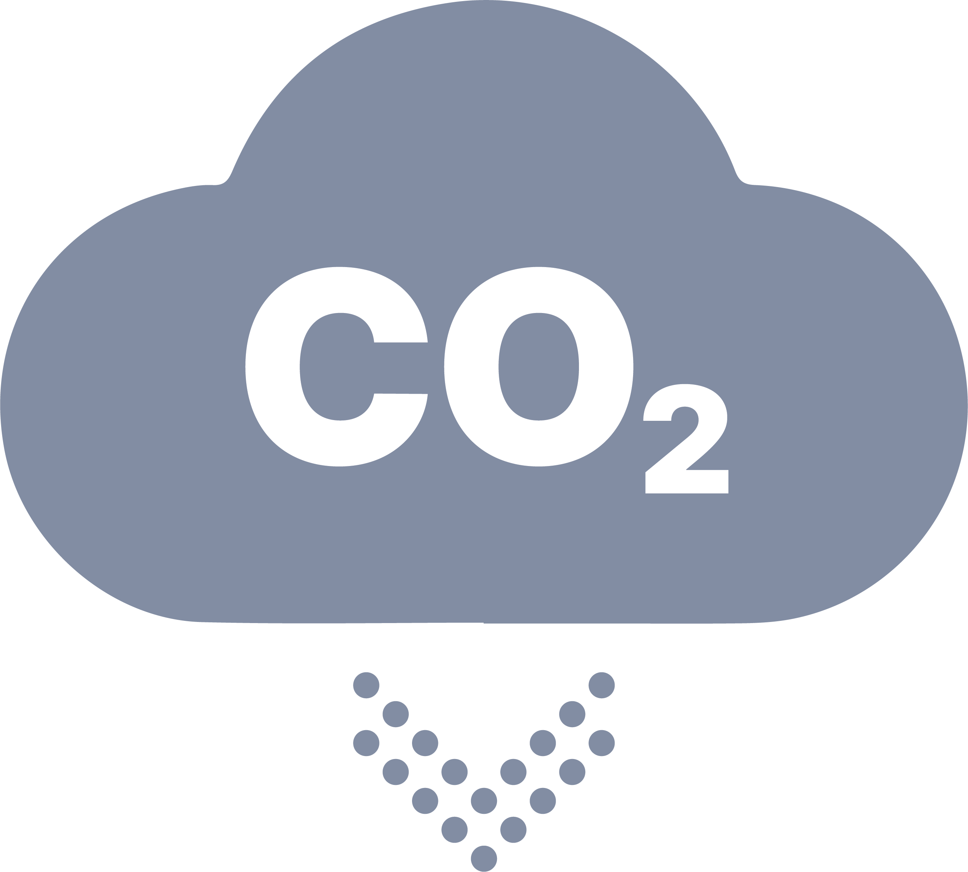
The Problem: Chemical Manufacturing
Today is Powered by Fossil Fuel Combustion
Feedstock In
Combustion to power the chemical value chain is responsible for:
RAW MATERIALS
Fossil Fuel Combustion (heat)
CHEMICAL VALUE CHAIN
Carbon Emissions
1 GIGATON
FINAL PRODUCTS
per year
Product out

Slide 4


The Solution: Syzygy’s Reactors Replace
Fossil Fuel Combustion with Renewable Electricity
Feedstock In
We reduce
carbon emissions
and lower cost
by electrifying
chemical production
Renewable Electricity
(Photons)
Carbon Emissions
Product out

Slide 5
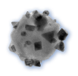
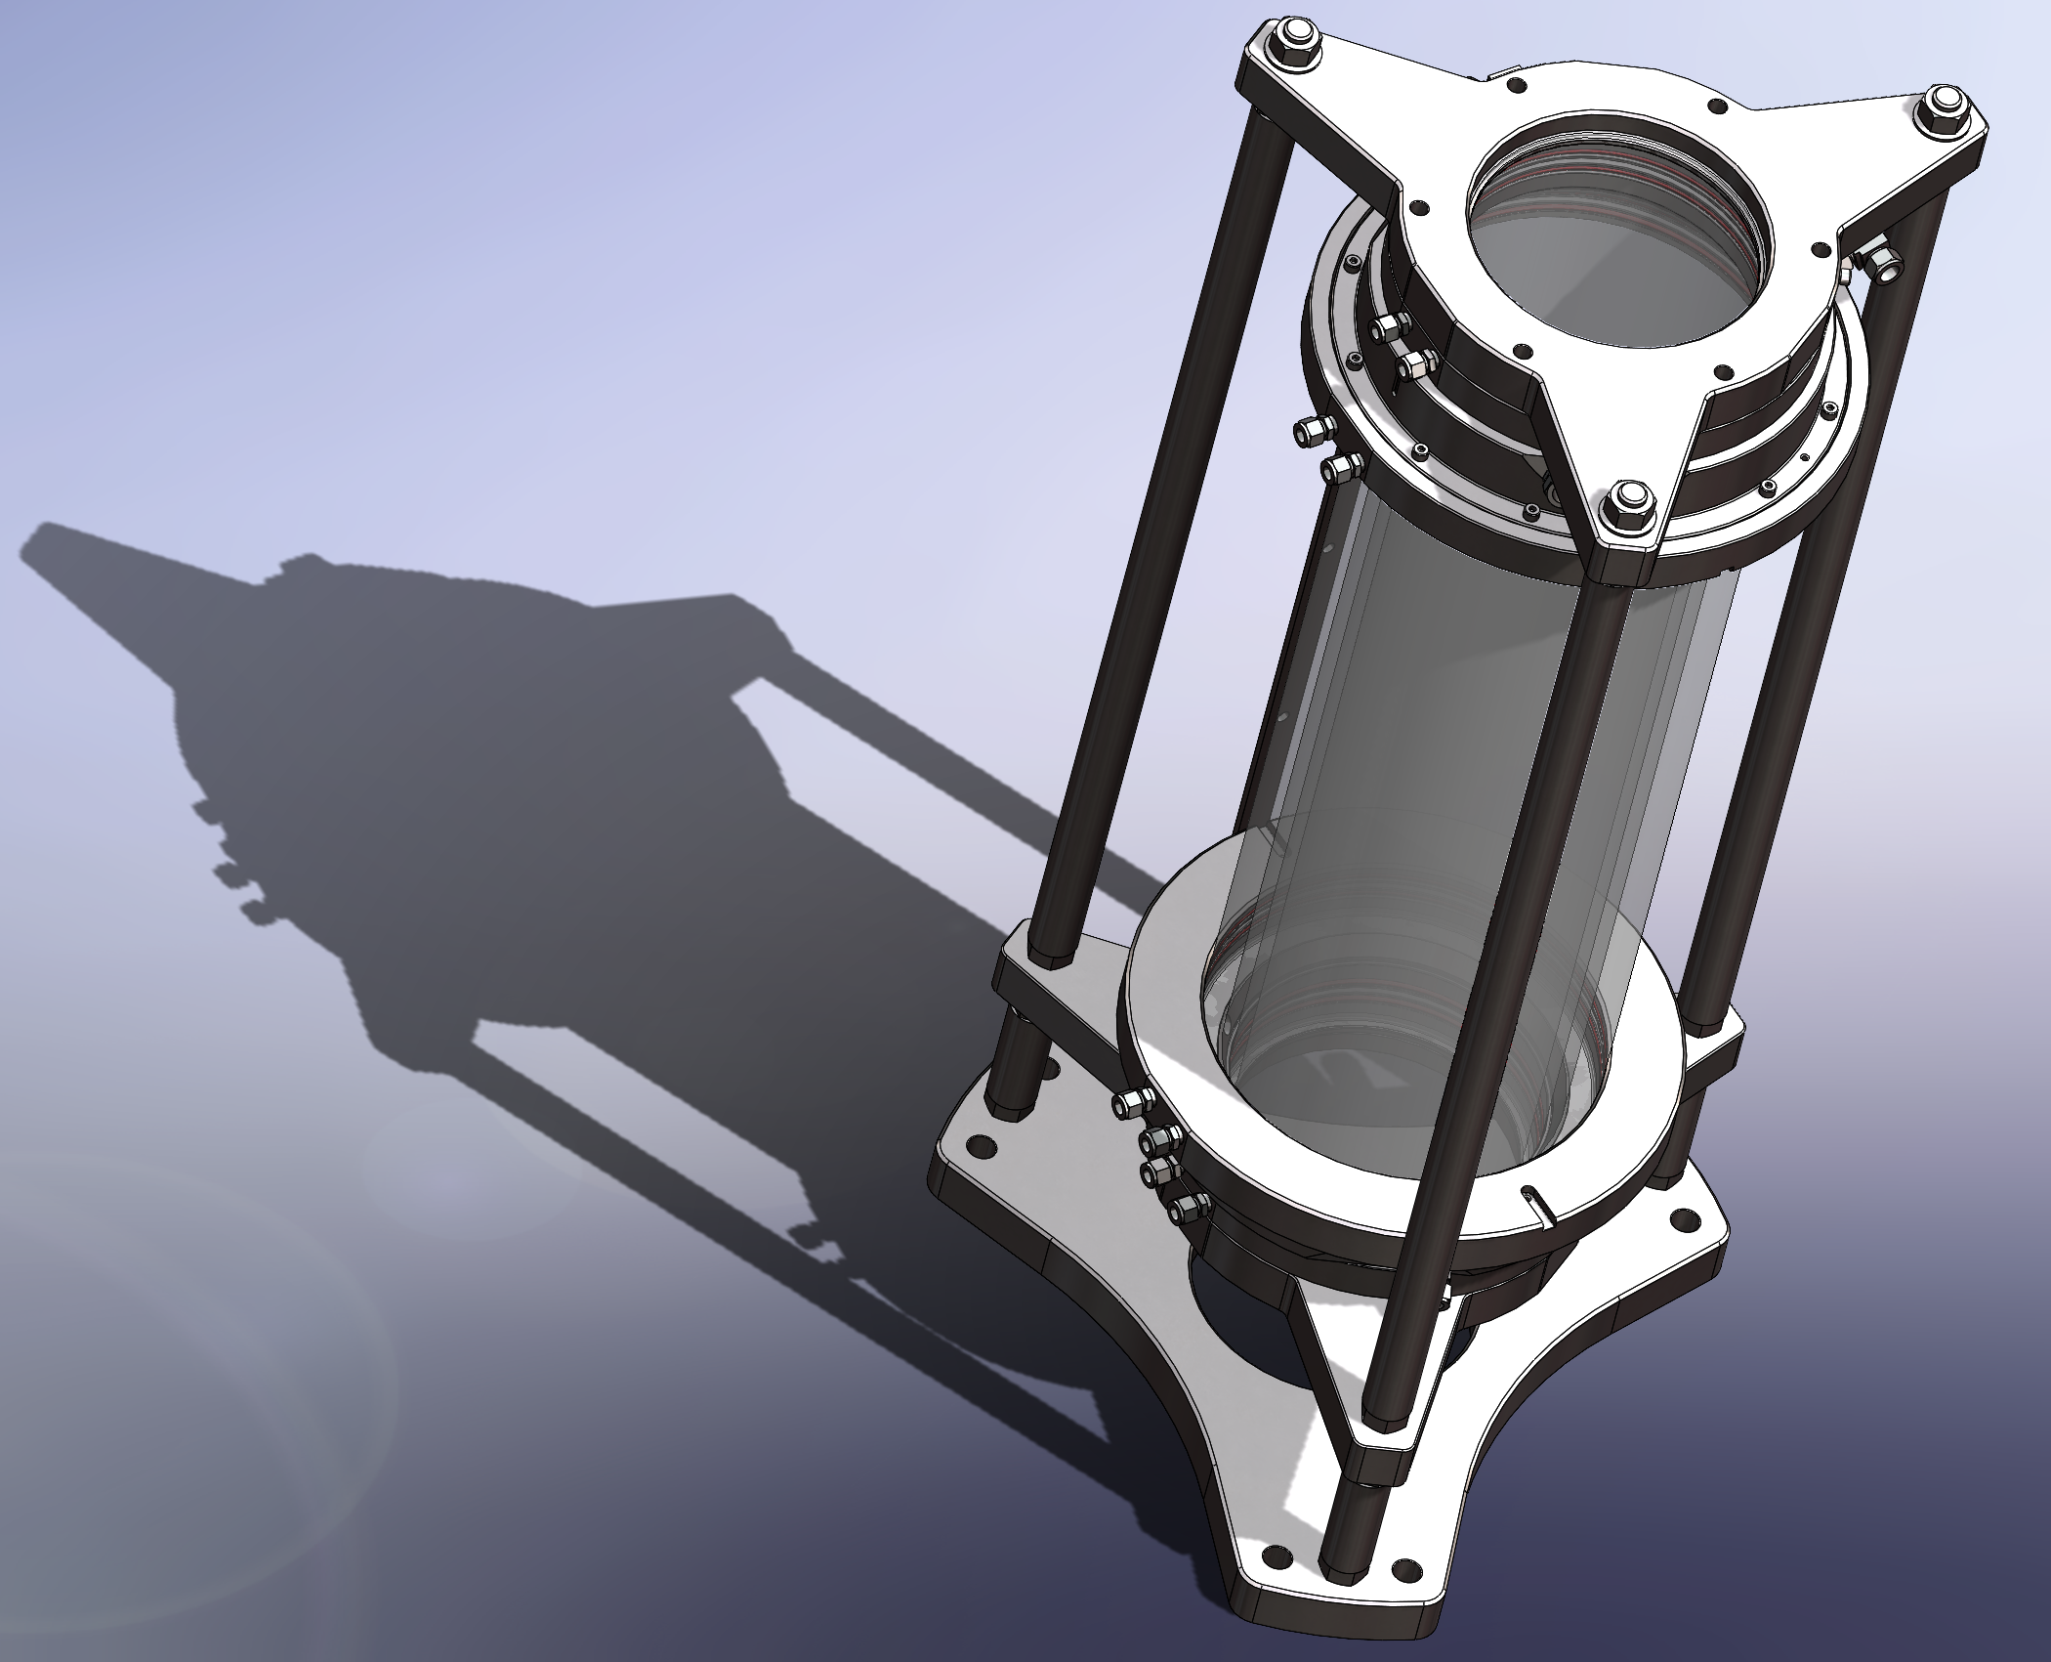
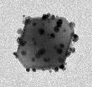

Two Complementary Innovations
Combine to Form Our Disruptive Platform
Science Innovation:
Photocatalyst Platform
Engineering Innovation:
Universal Reactor Platform
World’s first ultra-high performance photocatalyst
Multiple catalysts already developed for different reactions
Based on peer-reviewed nanotechnology from Rice University
One reactor design, multiple reactions
Flexible, low maintenance, zero-emission operations
Low-cost materials: Lower Capex
High efficiency: Lower Opex

Slide 6
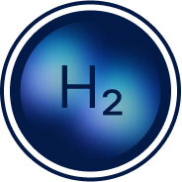
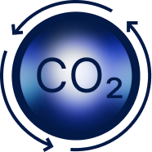
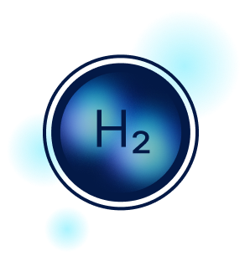
Syzygy Primary Pathways
PLATFORM TECHNOLOGY ALLOWS MARKET ENTRY WITH MULTIPLE PATHWAYS
Ammonia
Cracking to
Hydrogen
Greenhouse Gas to
Value
Combustion Free Steam Reforming
Our zero-emissions hydrogen solution leverages renewable electricity to transform green ammonia into clean hydrogen.
Save 25% compared to electrolysis
Our GHG-to-value solution processes the GHGs CO₂ and Methane into sustainable fuels and methanol.
Cut cost of SAF & methanol by 45%
Our solution eliminates combustion from traditional greenhouse-gas-heavy steam-methane reforming, making blue or biogas derived H₂ even more economical
Save 22% over conventional SMR

Slide 7
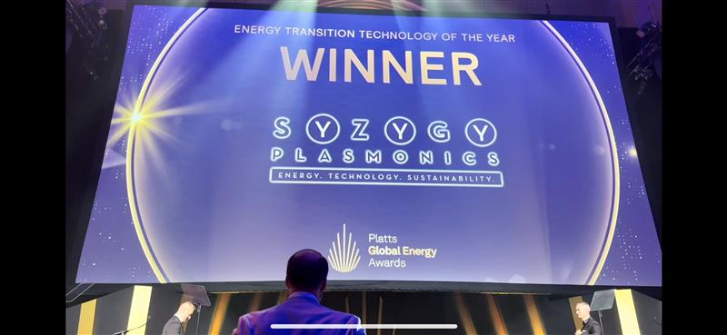

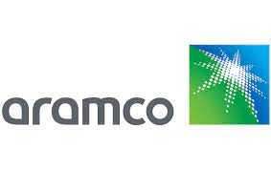
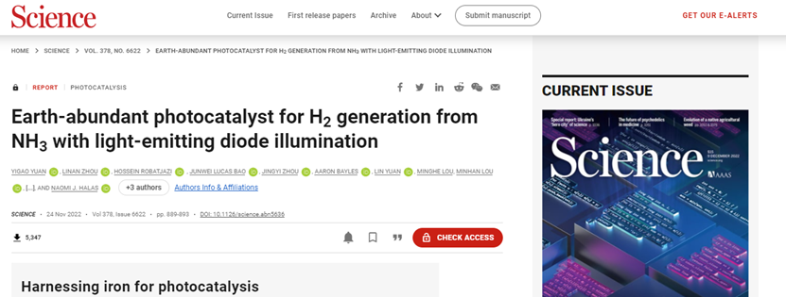
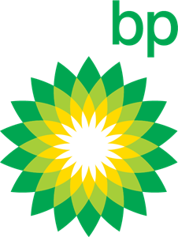
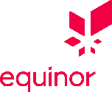

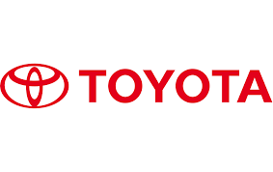


Poised for Success
Syzygy Attracts Investors and Customers from Across the World
Series C Overview
Capital Raised: $76mm
Lead Investor:
Strategic Investors:

Slide 8
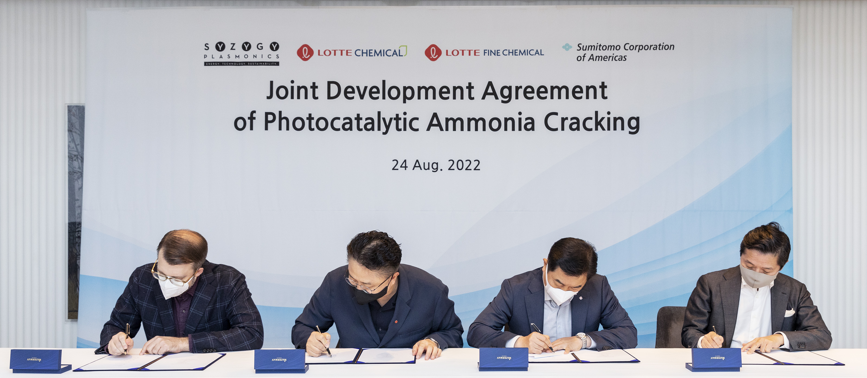
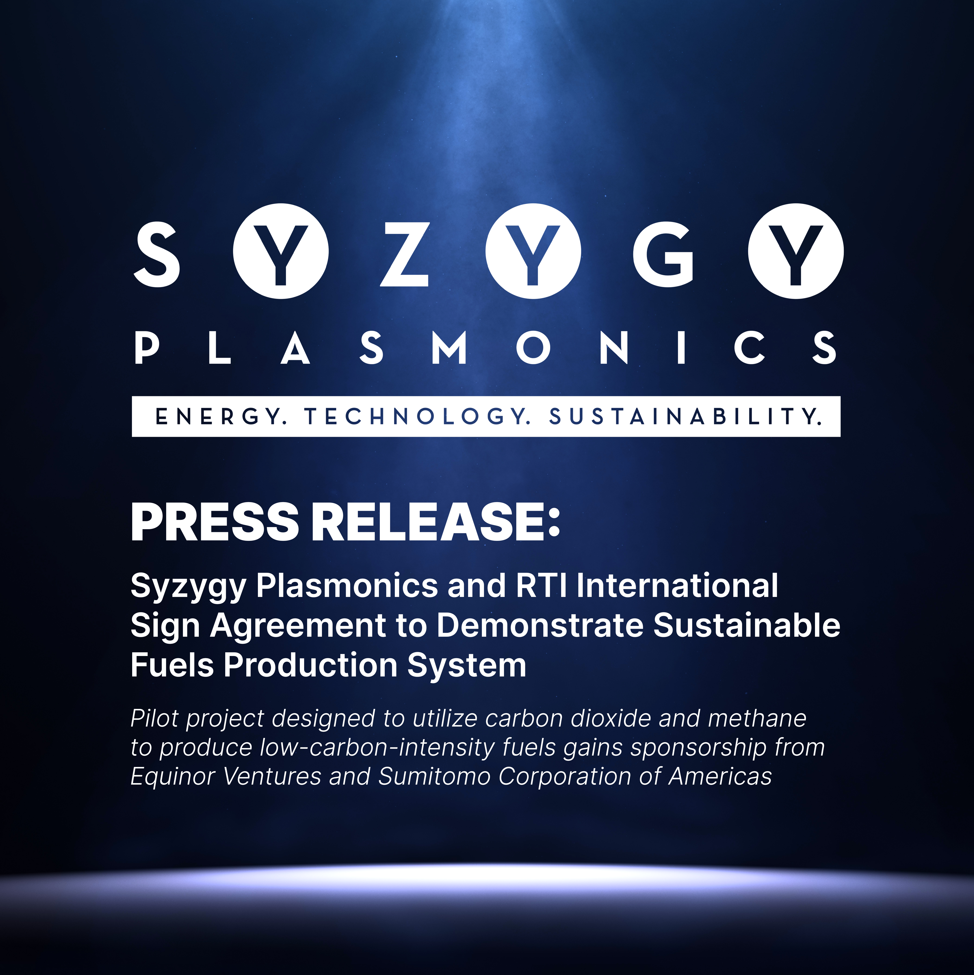
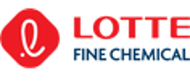

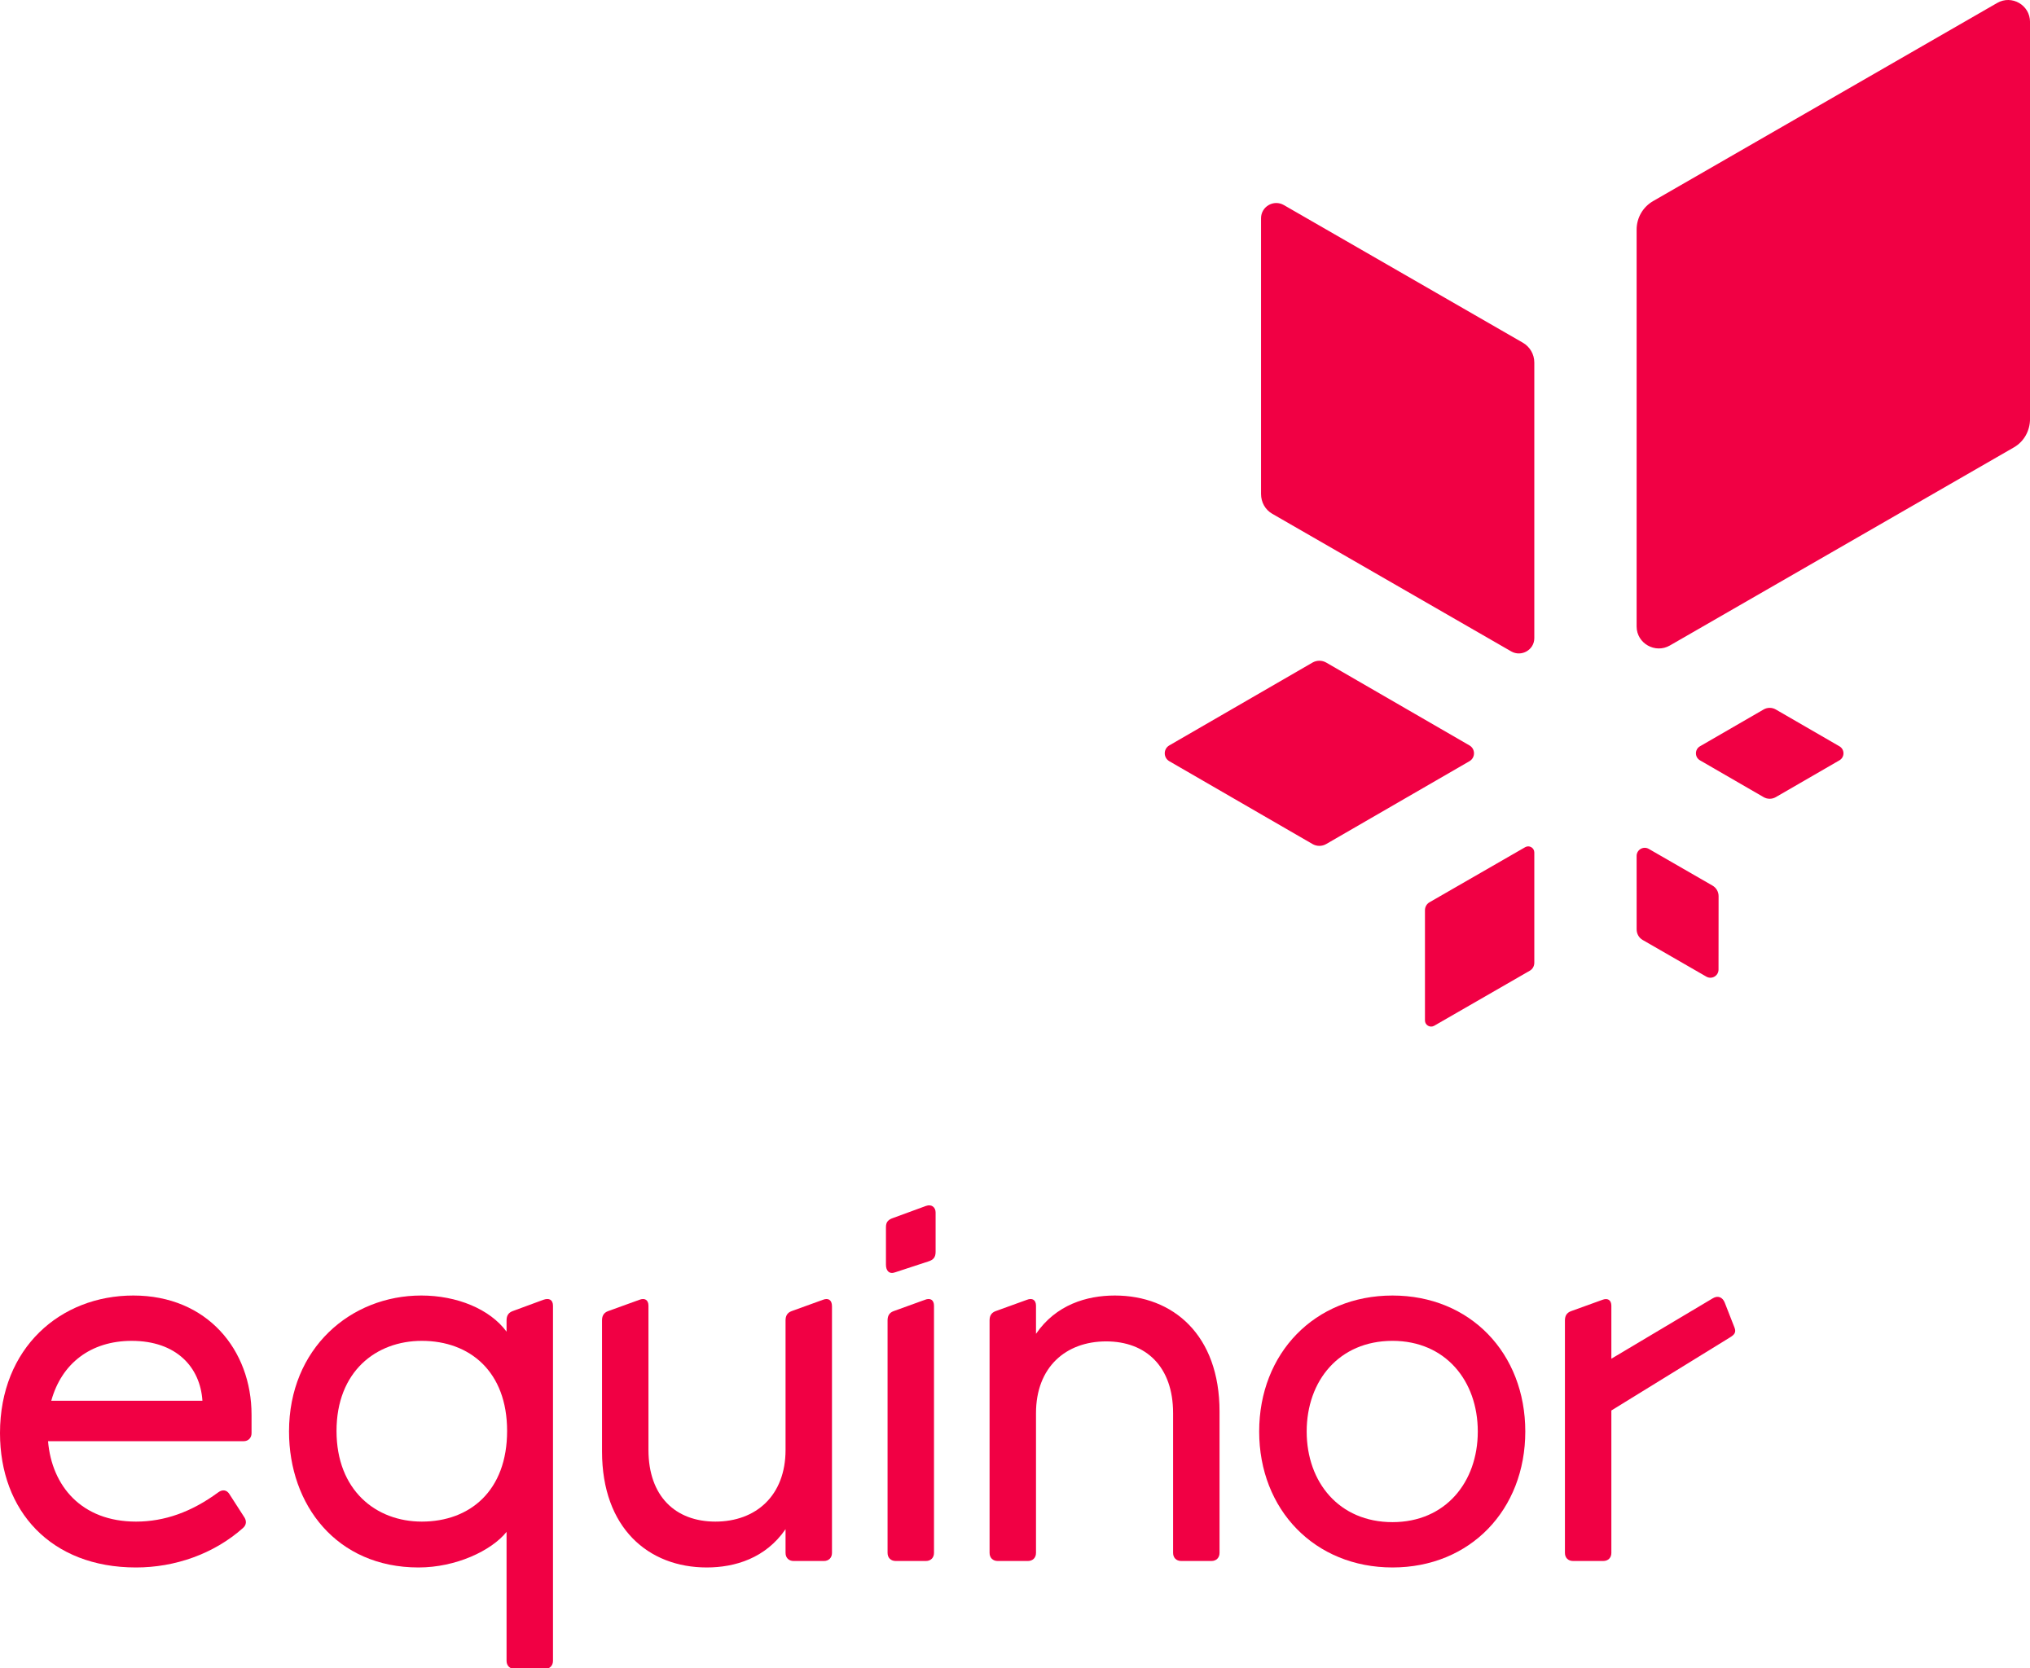
Leading Global Partners Drive Strong Commercialization and Impact
Zero-Emission H₂ In South Korea
CO₂-to-Jet Fuel in North Carolina
Zero-Emission H₂ in California
Ammonia splitting field trial with a Global Energy Major testing multiple use cases for P-DA
Global Energy Major
U.S.-Based
Global Integrated Energy Major
“We are proud to engage in scaling up the groundbreaking technology Syzygy has developed, and we are confident its application with LOTTE Chemical HQ will yield successful results.”
- Sumitomo
“We are excited about the opportunity to collaborate with Syzygy to test and assist in the scale-up of this promising technology.”
- RTI

