Slide 1
NextEra is a clean energy leader composed of two primary businesses
NextEra Energy Resources, LLC
World leader in renewable generation
28GW generation in operation
$62B in total assets
Operating across 48 states & Canada
40% of NEE operating revenue
NextEra Energy, Inc.
Fortune 200 company; NYSE: NEE
$169B market capitalization
61GW in operation
$19.2B operating revenue
$116B capital invested since 2011
Florida Power & Light (FPL)
One of the largest US electric utilities
More than 5.7M customer accounts
31GW generation in operation
$78B in total assets
60% of NEE operating revenue
As of March 31, 2022

Slide 2




For 25+ years, decarbonization has been our core strategy
NextEra Energy is the world’s leading sustainable energy company.
$156 B Total assets
Wind, Solar, & Battery Storage
61 GW of energy generation¹
28 GW of renewable generation in operation¹
18 GW of renewable generation under development¹
4.5 GW of battery storage operating and under development¹
Supply Chain
#5 investor
of capital
In THE us⁴
Engineering & Construction
$116 B capital invested from 2011-2021
Proprietary Analytics
47% better CO₂ emissions rate than industry average²
98% power generated from clean or renewable resources²
63% better operating costs than industry average^{2,3}
83% improvement in safety performance since 2003²
$17 B state and local taxes paid in 2020²
As of March 31, 2022
As of December 31, 2020
Florida Power & Light Company
In 2021, across all sectors - NextEra Energy internal estimates based on publicly-available information
2

Slide 3
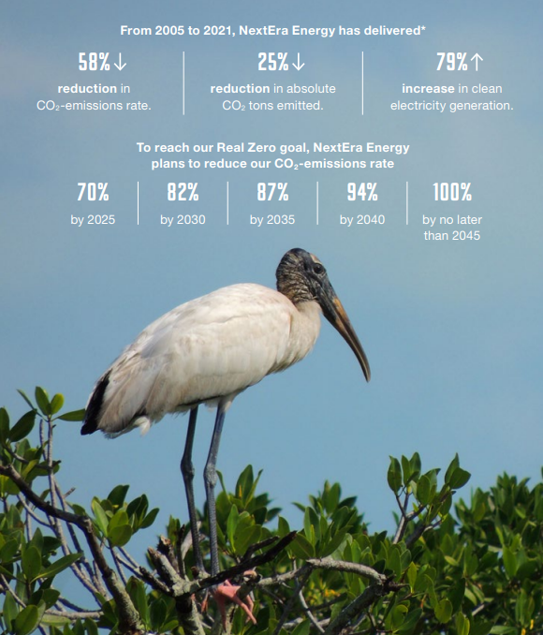
Nextera energy’s real zero goal
Our goal is to be completely carbon emissions free by no later than 2045
First – NextEra Energy
Decarbonize our own business, beginning with our goal to reach Real Zero emissions, without the need for carbon offsets, by no later than 2045. We’ve been prudently investing in decarbonizing our own operations for decades and this is an extension of our core values.
Second – US Power Sector
Decarbonize more of the U.S. power sector – investor-owned utilities (IOUs), municipalities and cooperatives – through continued investments and innovation in wind, solar, storage and green hydrogen projects.
Third – U.S. Economy
Lead the decarbonization of the U.S. economy – by working to become the preferred partner for customers to help them reduce or eliminate carbon emissions in their operations. We use our experts and data analytics to help our commercial and industrial customers reach their own net zero or strive to achieve Real Zero goals.
3

