Slide 1
March 30, 2023
Jakob Krummenacher & Kevin Bourgeois
Carbon Capture and Sequestration at El Dorado, AR Ammonia Plant

Slide 2
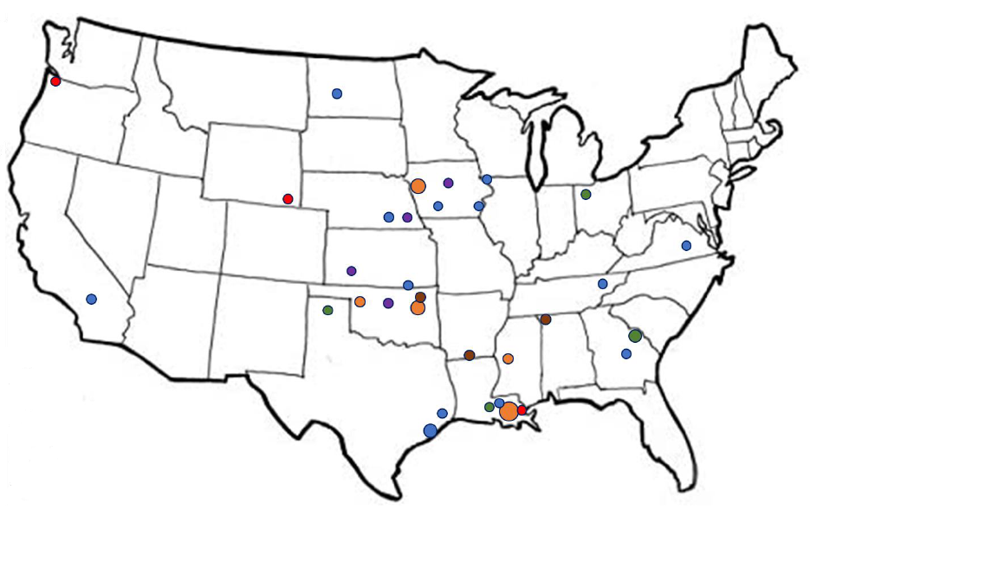
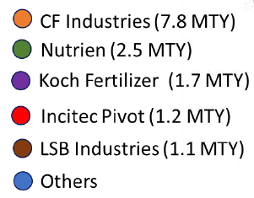
LSB Industries at a glance
Business Overview
LSB is the fifth largest ammonia producer in the U.S.
  LSB Industries, founded in 1968 and headquartered in Oklahoma City, OK, is a publicly traded company that manufactures and sells chemical products for the agricultural, mining and industrial markets
  $550+m in annual revenue in 2021
  Three production facilities strategically located near customer demand areas
  El Dorado, AR: Manufactures ammonia, ammonium nitrate, nitric acid, sulfuric acid, CO₂ and AN solution
  Cherokee, AL: Manufactures UAN, ammonia, AN solution, nitric acid, CO₂ and diesel exhaust fluid
  Pryor, OK: Manufactures UAN, ammonia and CO₂
Pryor
Cherokee
(0.9 MTY)
El Dorado
Revenue by Business
Nitric Acid
AN Solution
Products sold to market
Natural Gas
Ammonia Plant
UAN
CO₂
Urea
CO₂
Liquifaction

Slide 3
Globally a net of 40 Gt of CO₂e Greenhouse gas emissions are released into the atmosphere annually
Global greenhouse gas emissions by sector
Global greenhouse gas emissions by country
Source: IPCC (Intergovernmental Panel on climate Change), EPA (Environmental Protection Agency)
Buildings - include onsite energy generation and burning fuels for heat in buildings or cooking in homes
Other Energy – include indirect emissions from the energy sector, such as fuel extraction, refining, processing, and transportation

Slide 4
Hydrogen and ammonia are expected to be the main carbon-free energy sources in the future
ENERGY TRANSITION TO CLEAN ENERGY
Today
Tomorrow
Heating
Renewable Electricity
RNG
Hydrogen
Ammonia
NG
Electricity
Heating oil
Propane
Renewable Electricity
RNG
Power & Light
Renewable Electricity
Biomass & RNG
Nuclear
Hydrogen
Ammonia
NG
Coal
Nuclear
Renewable Electricity
Biomass
RNG
Mobility
Gasoline
Diesel
Bunker
Jet Fuel
Electricity
Renewable Electricity
Biofuels
Hydrogen
Ammonia
Biofuels
Renewable Electricity
Source: U.S. Energy Information Agency

Slide 5


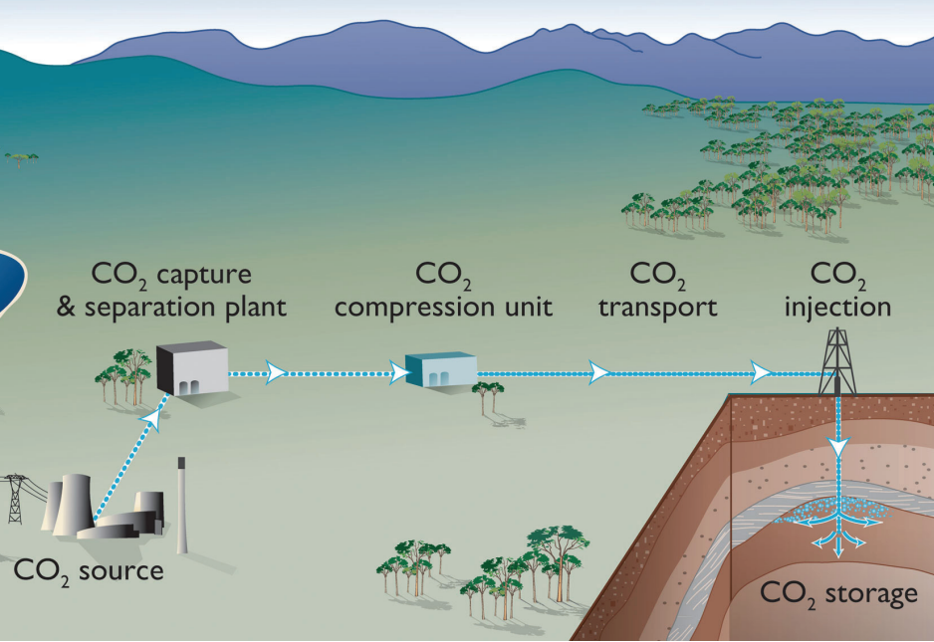
Producing low carbon ammonia at El Dorado, AR
Flue Gas CO₂
Process CO₂
Carbon Capture
Pipeline
Permanent Sequestration
Nat Gas
Water
Air
Steam Methane Reforming
H₂
N₂
Ammonia Synthesis
Low-Carbon Ammonia
450kt annually
Carbon Intensity down from 2.2 to 0.9
Nat Gas for heating
Agreement with Lapis Energy to develop the CO₂ capture and sequestration (CCS) project
Project will receive 45Q tax credits of $85 per metric ton of CO2 sequestered for the first 12 years of operation
Project operations expected to begin by mid 2025, subject to Class VI EPA permitting
Permanently sequestering >450k metric tons of CO₂ in saline formations directly under the facility. The sequestered CO₂ will reduce the company’s scope 1 GHG emissions by ~25% from current levels

Slide 6
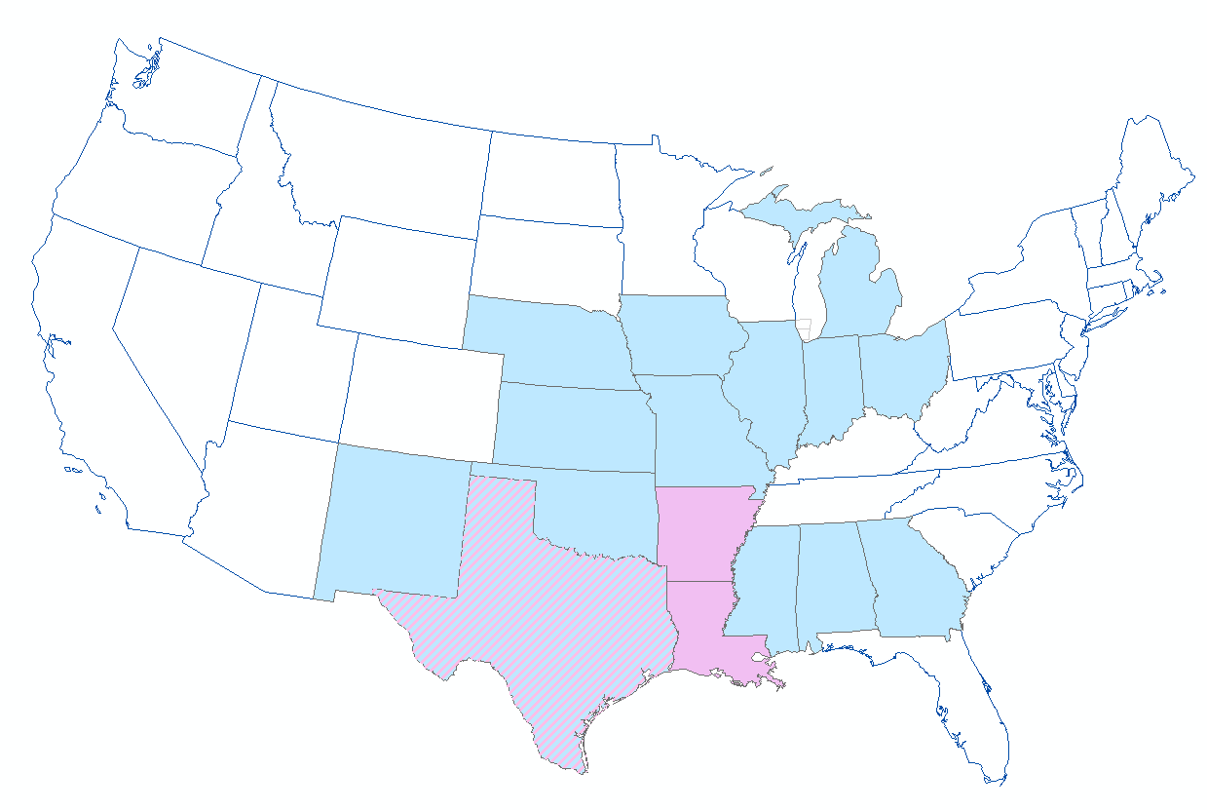
Lapis Energy
Our purpose is enabling industrial decarbonization through CCS
Lapis US Lower 48 Activity
Lapis value proposition
World class subsurface technical team
Entrepreneurial culture built from Kosmos Energy experience
100% capital commitment to FID
Expertise in CCS and energy transition
Proven capital large scale complex project delivery
Unburdened by fluctuations in oil price
Client focused decarbonization
Cresta financial sponsorship

Slide 7
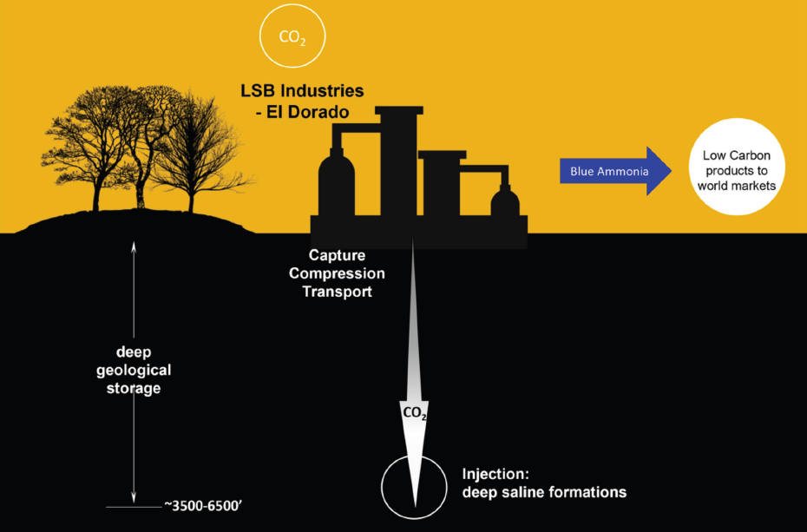
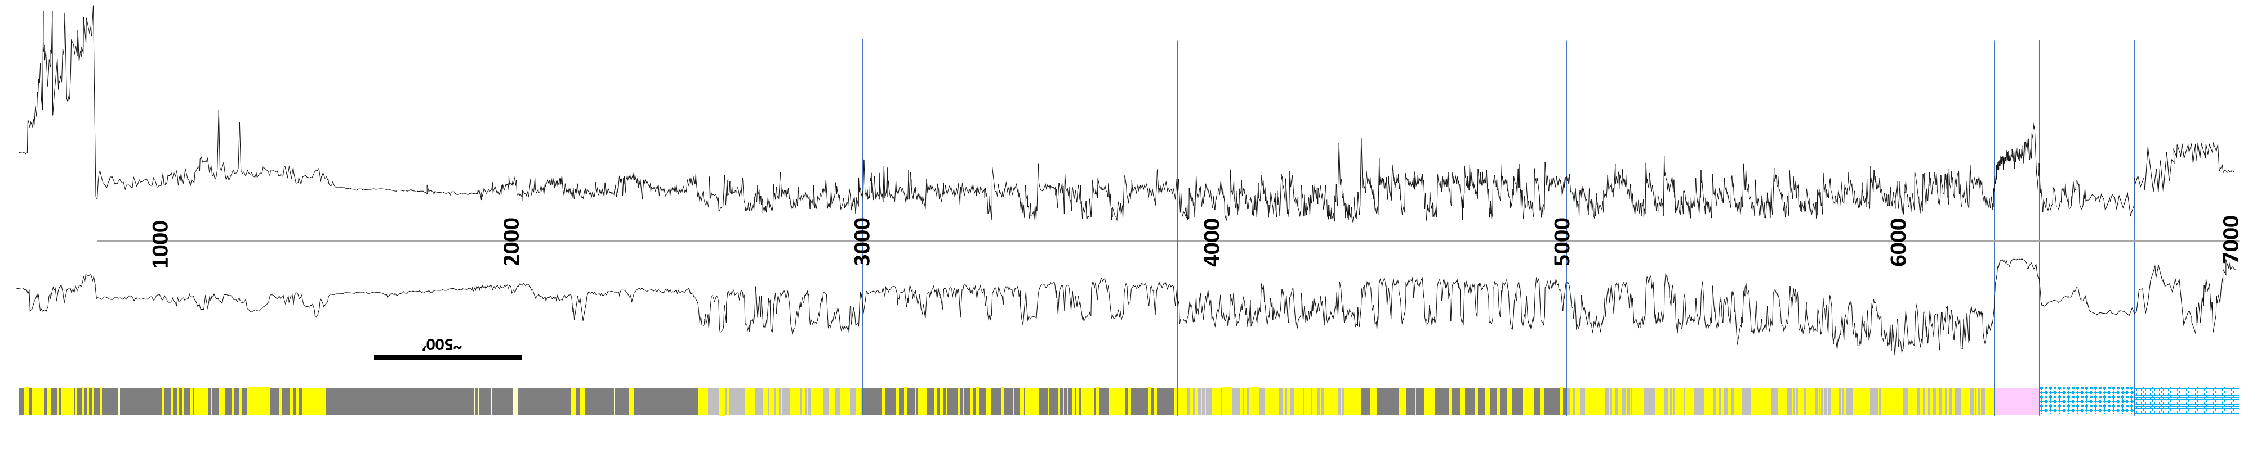
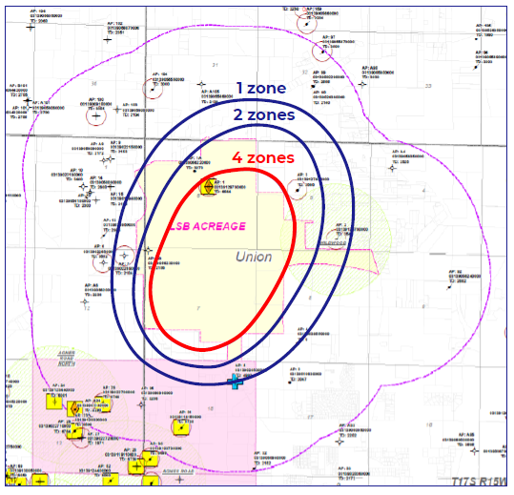
How will CO₂ be captured and stored at El Dorado?
surface
The reservoirs holding the CO₂ are approximately 3500-6500 ft below the surface and 3000 ft below the area drinking water supply.
A 1000 ft thick, impermeable layer of shale separates the injection zone and the area drinking water and prevents any upward migration of CO₂
A stringent set of safety requirements will need to be satisfied before the U.S. Environmental Protection Agency (EPA) will give permission to start CO₂ injection.
CO₂ injection pressures will be very carefully monitored by monitoring wells installed to further ensure integrity
Increasing the number of possible injection zones will reduce the plume size significantly, and thus the need for private pore space rights.
Sparta Aquifer (El Dorado Drinking Water)
1,000 ft
Cane River
Seal
Wilcox
2,000 ft
Midway
Seal
Arkadelphia
Nacatoch
Taylor
3,000 ft
Tokio
Seal
Eagleford
critical depth for C0₂
Woodbine
(Tuscaloosa)
4,000 ft
Hosston
Travis(Peak)
4
CO₂ Injection Zone
Seal
Monitoring well
5,000 ft
o
3
Cotton Valley
2
CO₂ Injection Zones
x
o
Injection well
6,000 ft
1
o
Buckner
Seal
Monitoring well
Reynolds
7,000 ft
Smackover

Slide 8
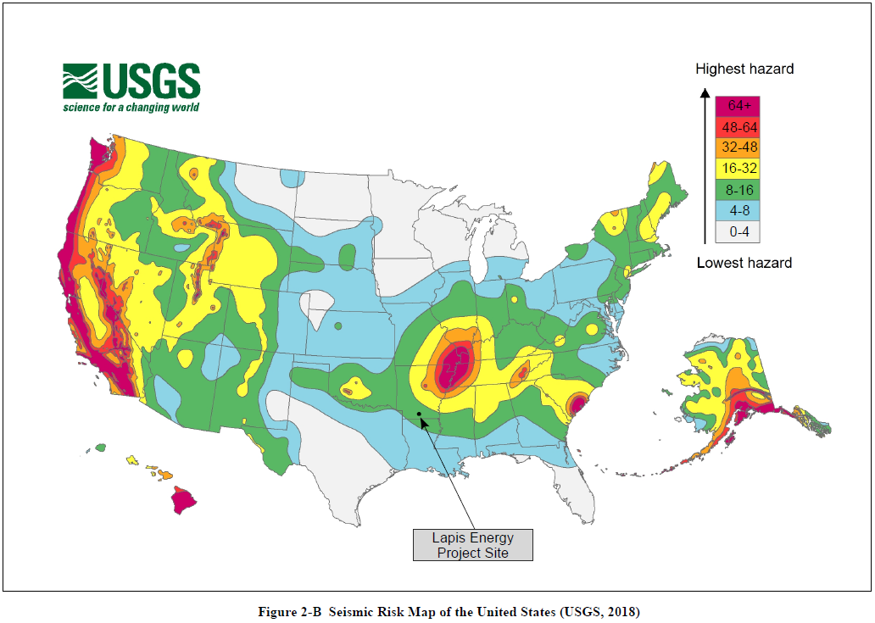
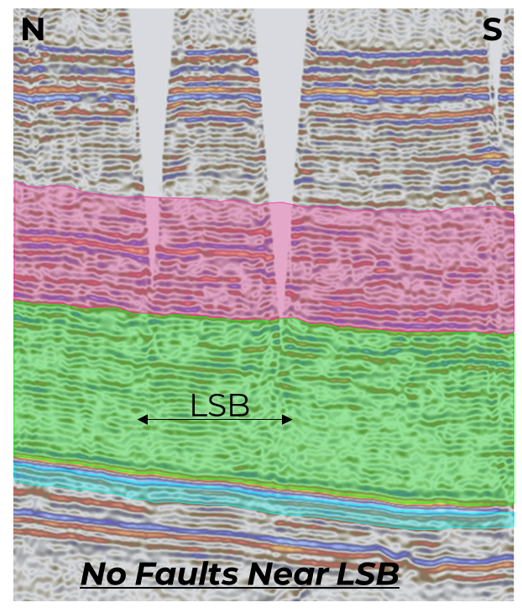
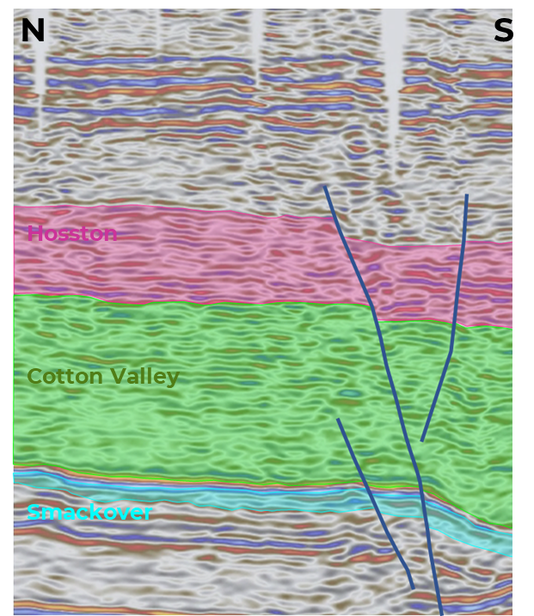
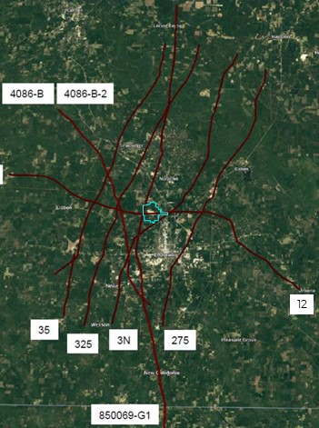
Seismicity considerations
Very low seismic activity, no subsurface faults near the LSB property which could be reactivated
seismic line A
seismic line B
2D Seismic
Purchased 2D seismic grid to constrain structural model and demonstrate lack of faulting
PSTM re-processing to increase imaging quality
No copies or screen captures allowed of this slide for copyright reasons

Slide 9
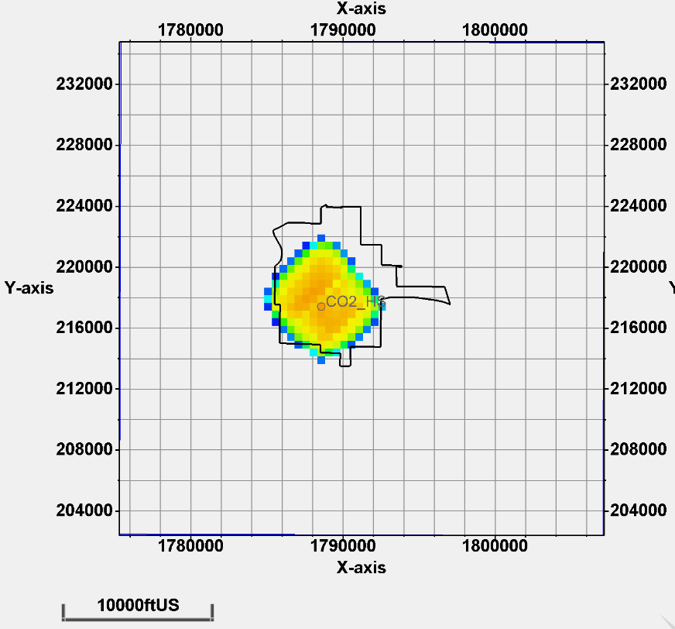
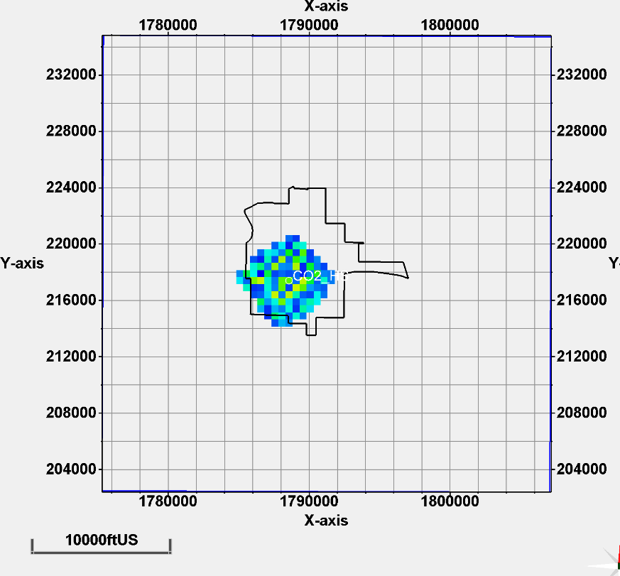
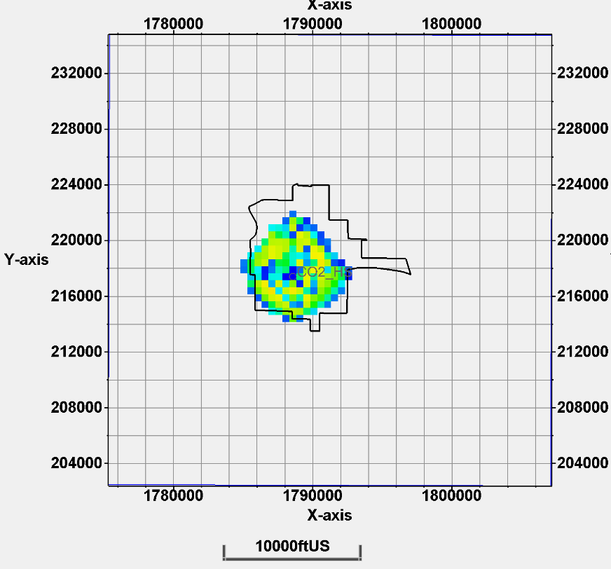
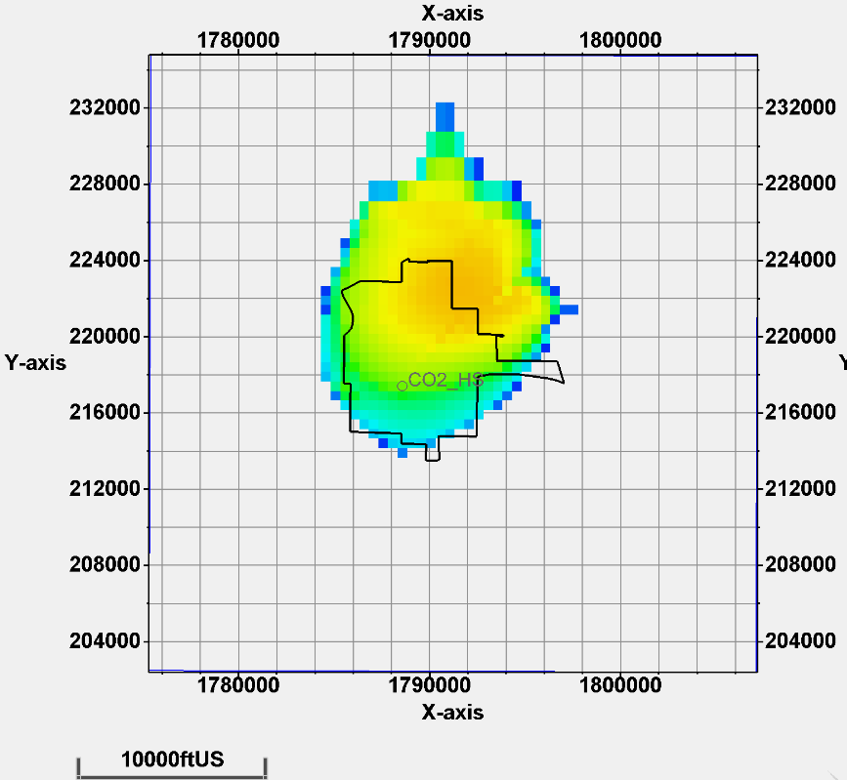
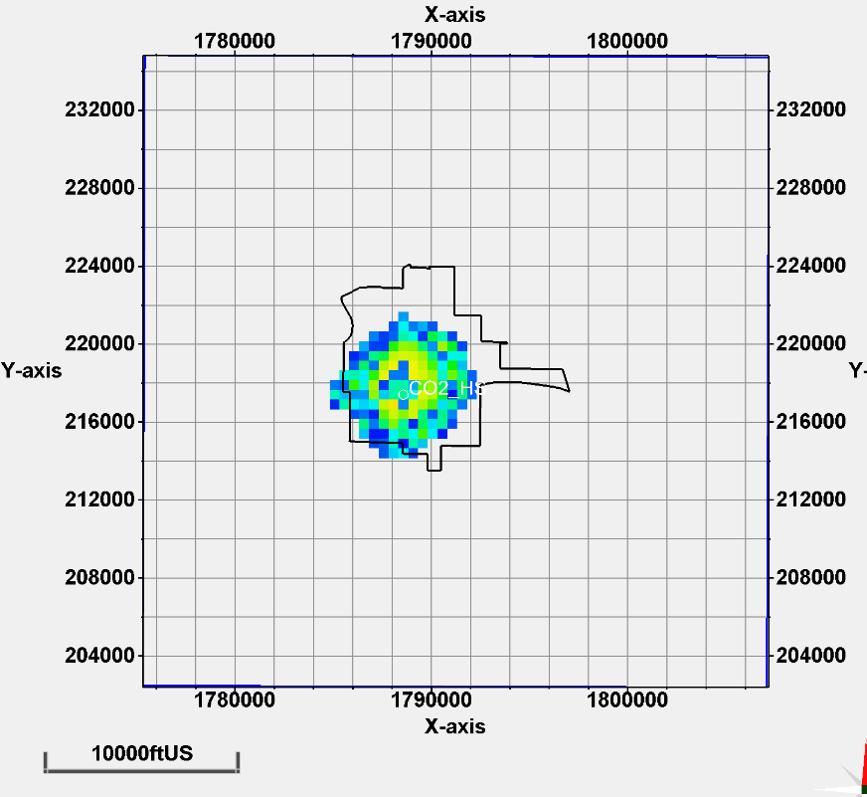
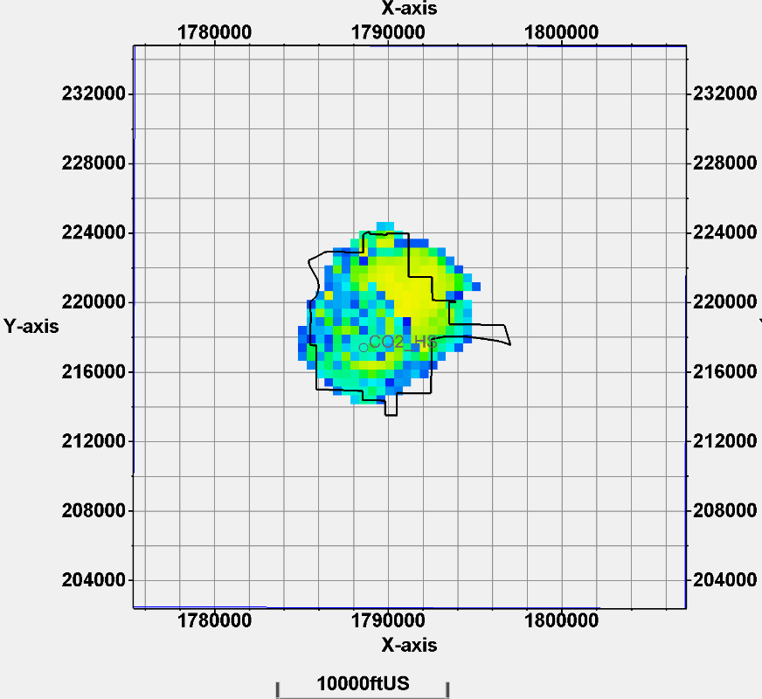
Managing the CO₂ plume for 50 years post injection
Smackover
Cotton Valley 1, 2 & 3
Hosston
Models include dissolution, but not hysteresis (would reduce plume size further)
4 injection intervals provide redundancy if one or two zones are not connected to enough pore volume, or the plume expands too aggressively
Consider injecting longer (5-10 years) in some of the Cotton Valley intervals if well connected
Smackover has a large plume size because of high permeabilities, salinities & Kv/Kh - excluded
After 5-year injection
After 50-year post injection

Slide 10
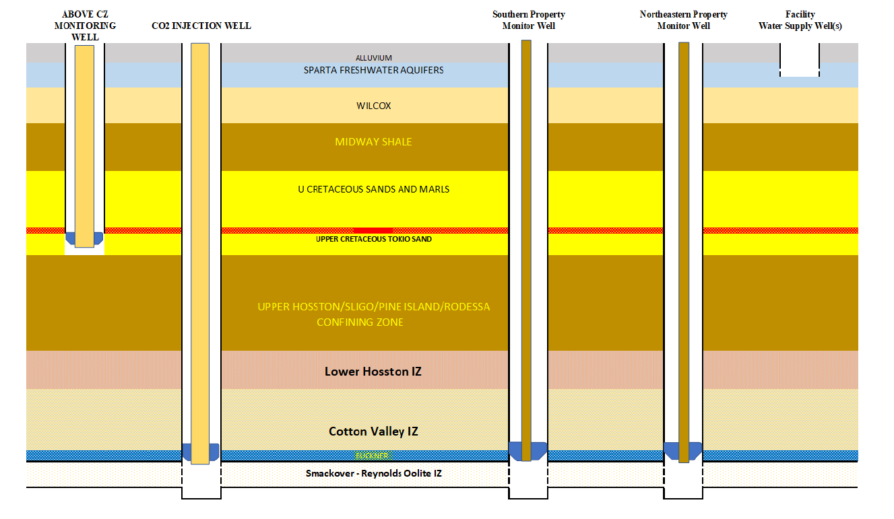
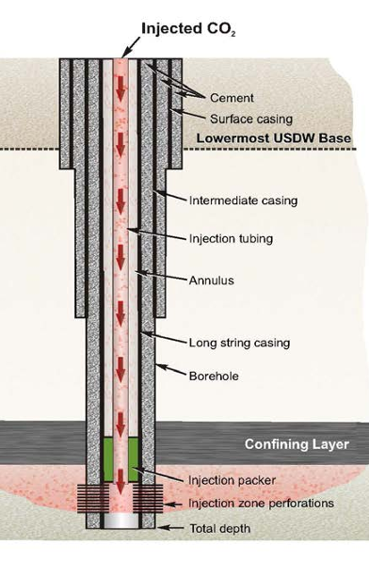
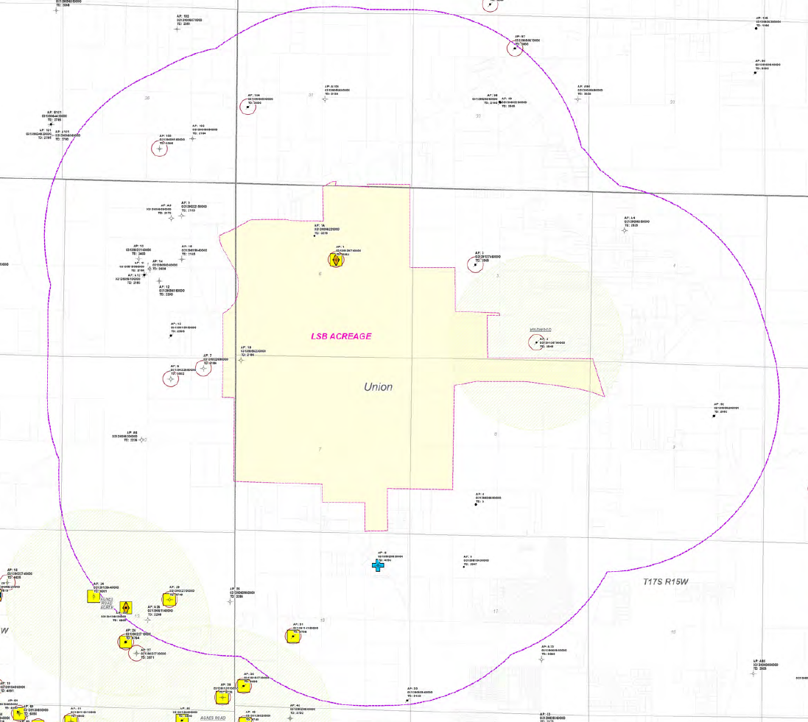
Proposed monitoring scheme and injection well
Initially two deep monitoring wells and one shallow monitoring location, one injection well
In-zone monitoring
plume and pressure
Injection Well
Above injection zone plume and pressure monitoring
In-zone monitoring
plume and pressure
EPA cementing and casing requirements
Firm-up well locations, based on final dynamic modelling
Supplement subsurface monitoring with indirect monitoring; 4D VSP, 4D sparse array seismic or 4D 2D
Once plume hits a deep monitoring well a new deep monitoring well will have to be drilled further away to track further plume expansion, or injection will have to be moved up to the next zone
EPA well construction requirements are aimed to protect the USDW and provide zonal isolation

Slide 11

Schematic of the CO₂ capture facility
CO₂ COMPRESSION AND DEHYDRATION PLANT
COMPRESSOR
STAGE 1-3
COMPRESSOR
STAGE 4-5
AMMONIA PLANT GENERATING CO2
BLOWER
TEG DEHYDRATION
COMPRESSOR
STAGE 1-3
COMPRESSOR
STAGE 4-5
SUBSURFACE
INJECTION PLANT

Slide 12
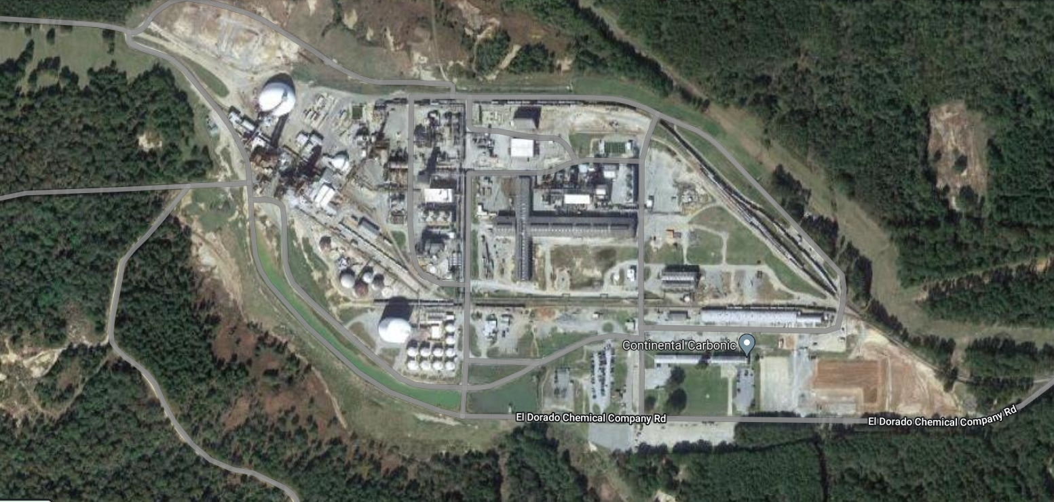
Location of the capture facility and CO₂ pipeline
Compressor Plant
CO2 Supply
CO2 Injection
Bridge over tracks
New pipe rack
Bridge over road
Bridge over pond
Bridge over road
Existing pipe rack
Well ~400m S of plant

Slide 13
Project Timeline
Expecting injections to start in 1H 2025
Complete Feasibility
Secure pore space
Final plume model
Progress Class VI
Class VI well submittal
Finance & tax equity FEED
Drilling
Class VI injection
submittal
1
2
3
4
5
6
7
~2Q 2022
~3Q 2022
~4Q 2022
~1Q 2023
~1Q 2024
~4Q 2024
~1H 2025
Months
2
6
9
12
24
32
40
EPA engagement
Subsurface & Class VI Permit
Plume Model (prelim.)
Final Dynamic Model
Initial submittal
Class VI approval to construct
Incorporate well data into report
Final submittal
Class VI Injection approval
Plume Model (final)
Class VI Well Design
Class VI Well Permit EPA Interchange
Class VI Injection Permit EPA Interchange
Land, Regulatory & ESG
Define Land Rights
ESG stakeholder engagement
Pore Space
Financial Structuring
TE commitment
Funding & Closing
Commissioning
Tax Equity Prelim DD
Tax Equity and Debt
Financing Commitments
Engineering Design & Construction
FEED
Order long lead items
Capture Facility Construction
Concept Engineering
Detailed Engineering
Drill Wells
Commercial
Startup injection
Commercial Agreements

Slide 14
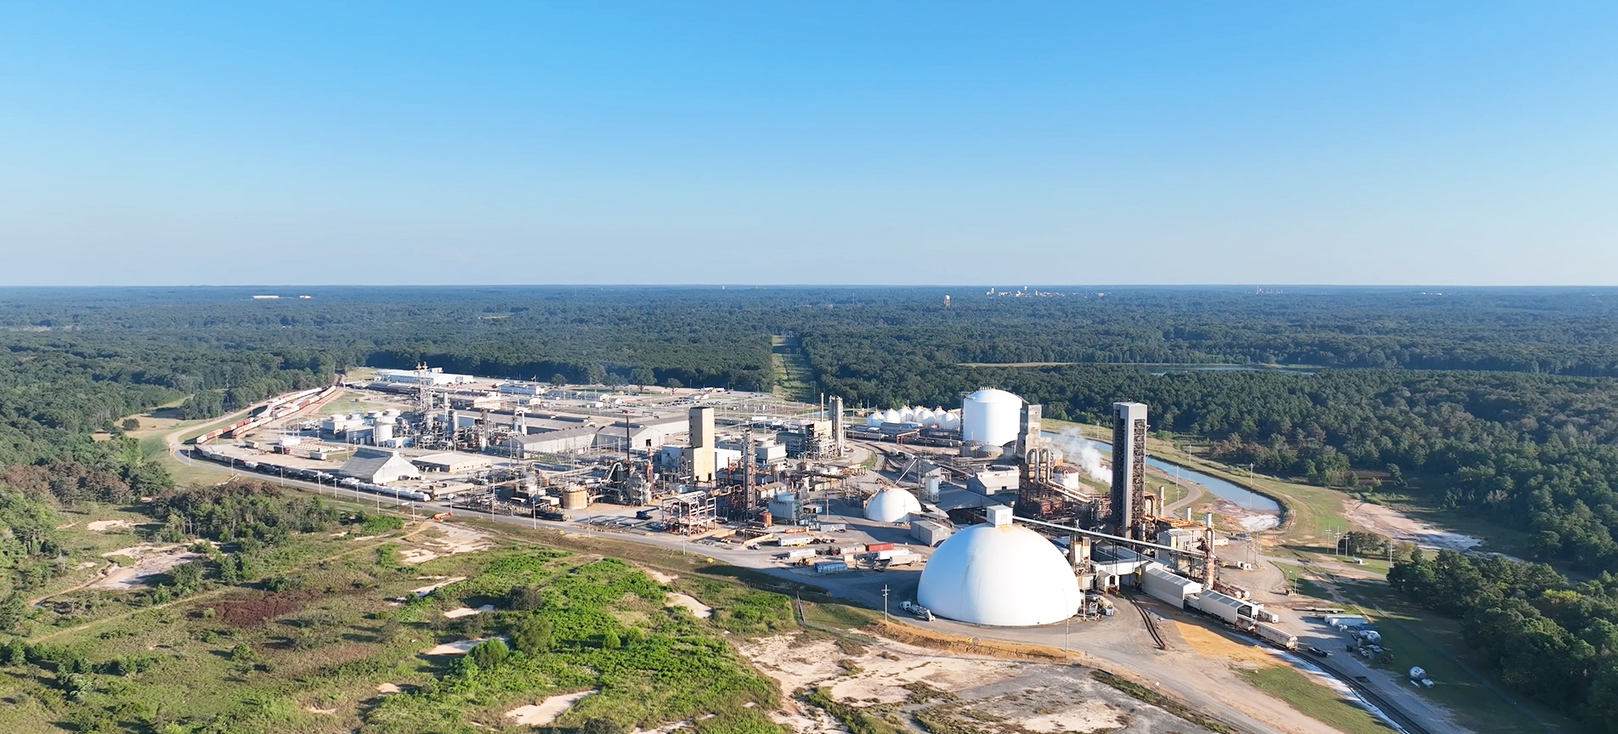
Questions?
LSB Industries – EL Dorado Chemical Plant

