Slide 1
Building a Better Future Using Carbon for Good
March 2023
Notes:
Thanks! Great to be with you, and back in Houston after many years.

Slide 2

Explainer Video
To increase awareness of climate change and the mitigating role that concrete can play, CZI funded a campaign during NY Climate Week 2022.
Notes:
With that, I’ll let this short video do the hard work of introducing you to our technology.

Slide 3




CarbonBuilt’s solutions are based on a decade of research, development and demonstration
Foundational Research
2013 - Present
Building a Better Future Using Carbon for Good
Building a Better Future Using Carbon for Good
Notes:
CarbonBuilt is focused on unlocking concrete’s immense potential as a decarbonization tool, and we’re doing that as a solution provider to the existing concrete industry.
A bit of background on our company…
Our foundational technology was conceived a decade ago at UCLA

Slide 4
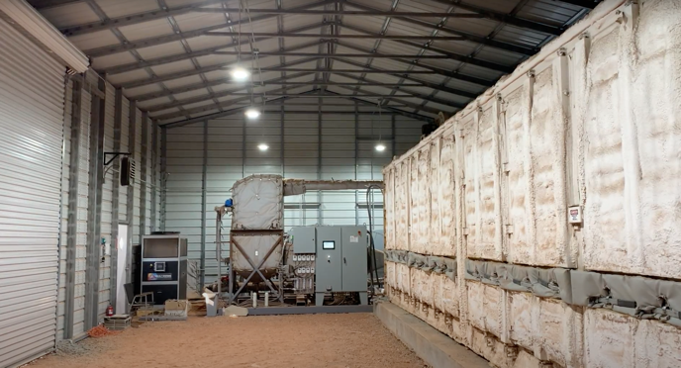


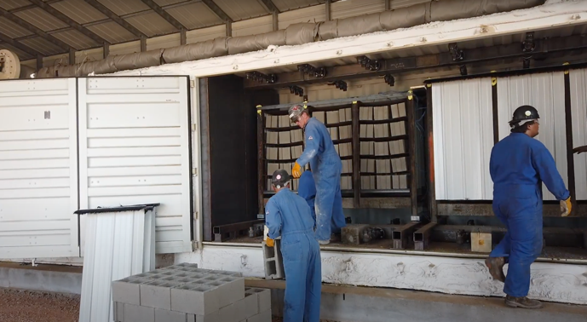



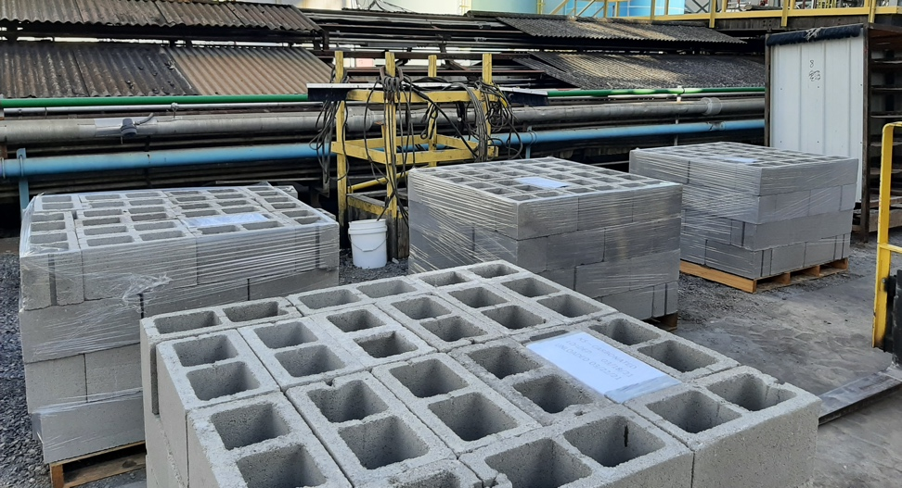


CarbonBuilt’s solutions are based on a decade of research, development and demonstration
Foundational Research
2013 - Present
Scale Demonstrations
2019 - 2021
Building a Better Future Using Carbon for Good
Building a Better Future Using Carbon for Good
Notes:
…work that culminated in two tenth scale demonstrations, the Grand Prize award in the NRG-COSIA Carbon XPRIZE competition, and lots of industry engagement ranging from third party testing to show that products made with our technology meet all required specifications to ISO-certified life cycle analysis conducted by external experts.

Slide 5











CarbonBuilt’s solutions are based on a decade of research, development and demonstration
Foundational Research
2013 - Present
Scale Demonstrations
2019 - 2021
Commercialization
2021 - Present
Investors
Carbon Credit Buyers
Other
Partners
Building a Better Future Using Carbon for Good
Building a Better Future Using Carbon for Good
Notes:
Since early 2021, we’ve been focused on commercialization.
We’ve been joined on this journey with a host of leading investors, the world’s most thoughtful carbon credit buyers and others from both outside and inside the concrete industry.

Slide 6
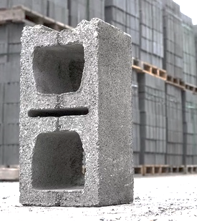
CarbonBuilt reduces the embodied carbon of concrete products
by 70 to 100+%...
…with no compromise to price, performance, or
plant operations.
Today.
Notes:
So just in case that didn’t come through clearly, we substantially decarbonize high volume concrete products, with no compromises to the other things that matter. And we are doing this now.
I’ll note that while we have ambitions in other geographies and product segments, and have technology in the pipeline for those other products, the US masonry market is our beachhead.
Three reasons for this: 1) we offer a compelling economic value proposition to key decision-makers in the value chain ((tech as-is, no govt involvement, no need for structured finance) 2) big enough opportunity (economically and climate-wise) for us to build a company around, 3) as we all know, focus is a critical determinant of startup success.

Slide 7
CarbonBuilt’s technology delivers substantial margin growth for concrete producers
Cost Reduction
10 to 30% reduction in cost of raw materials and utilities
Carbon Credits
Driven by 60-100% reduction in cement and ~2% carbon uptake
Volume Growth
Strong demand for decarbonized products with no green premium
Building a Better Future Using Carbon for Good
Notes:
After spending almost 20 years working on or investing in technology-enabled climate solutions of one kind or another, let’s just say that I am viscerally aware of the importance of delivering an economic value proposition to your customer. Particularly for commodity products like concrete.
Beyond its carbon benefits, implementation of our technology delivers meaningful economic value to a producer… most tangibly a 10 to 30% reduction in the cost of raw materials and utilities- costs which can account for 40-50% of revenue.
On top of that we enable new revenue in the form of carbon credits from both the permanent storage of CO2 and the avoidance of carbon emissions associated with the reduction in cement usage.
Less quantifiable, but almost certain to occur, is the margin expansion that comes from volume growth that will come for producers offering decarbonized product without a premium.
Generally a low margin business, so these changes can easily double or triple net margin. This enables quick year payback of the retrofit capex which is about $1.5M for the most common production line size, and again this is without government tax credits, grants or procurement incentives which can of course play an accelerating role. Tough to find opportunities like this in the climate landscape.
Let’s talk about our commercialization progress.

Slide 8
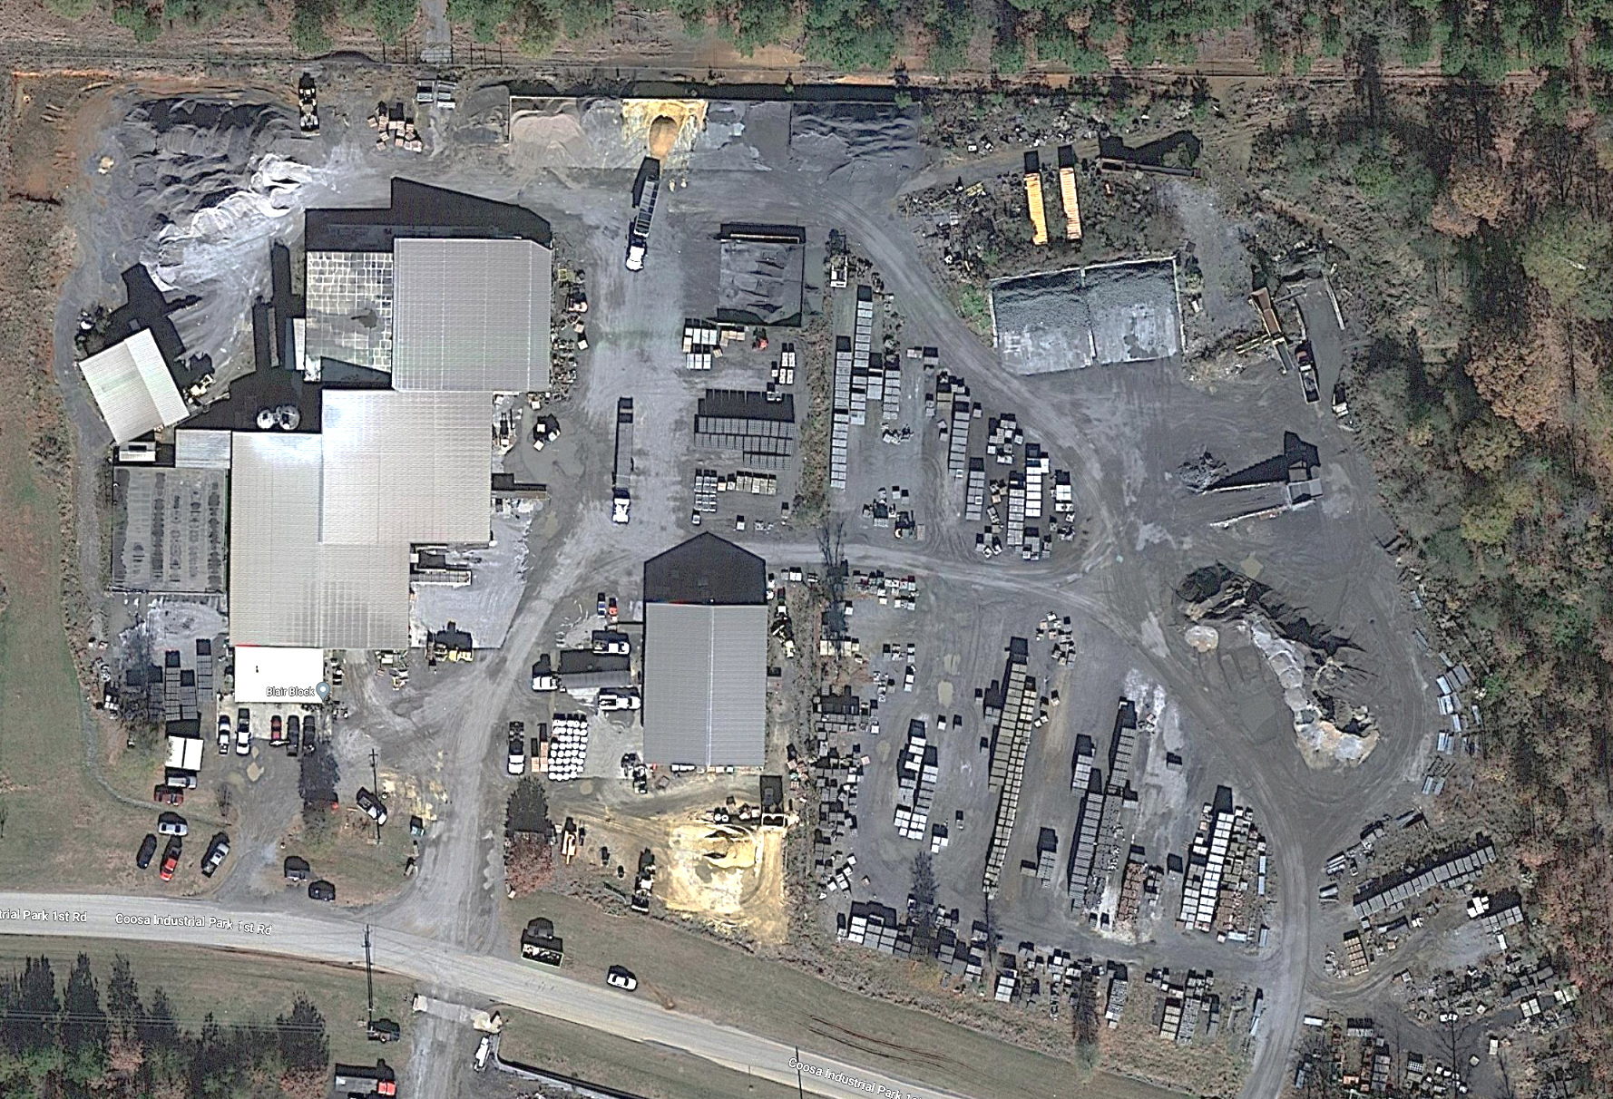
CarbonBuilt’s first producer partner is Blair Block, near Birmingham, AL
Curing
Chambers
Block Line 2
Curing
Chambers
Block Line 1
Building a Better Future Using Carbon for Good
Notes:
Here’s an overhead view of our first commercial partner, Blair Block.
This is a very typical plant with two average size production lines, each of which has its own curing chambers.

Slide 9
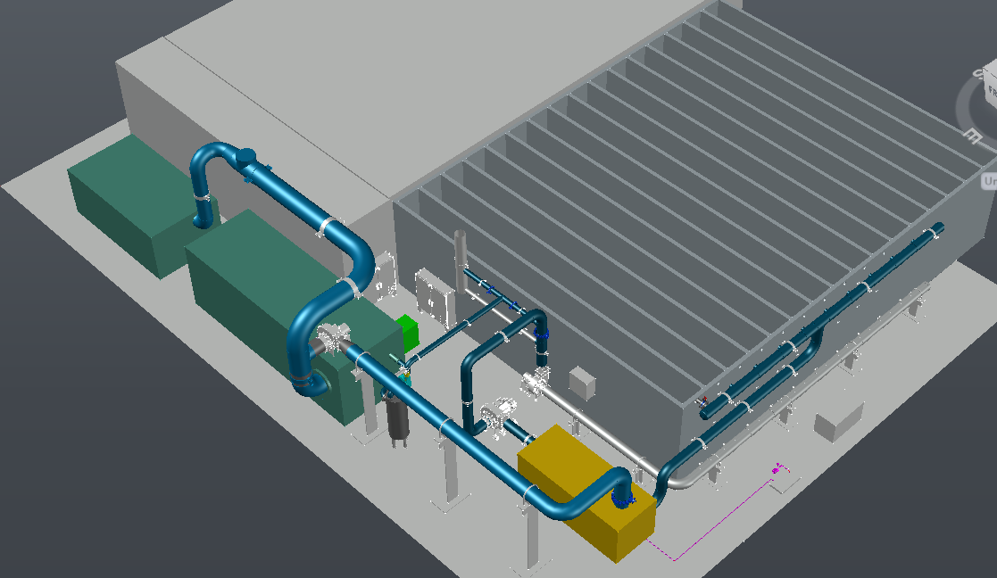
CarbonBuilt’s first producer partner is Blair Block, near Birmingham, AL
Building a Better Future Using Carbon for Good
Notes:
CAD drawing of our retrofit…
Our CO2 source for this plant is waste biomass from the local forest products industry.
We have retrofitted line 2, and all of our equipment – a biomass dryer, biomass furnace and gas processing system – fits in the yellow area on the outside of line 2’s curing chambers.

Slide 10

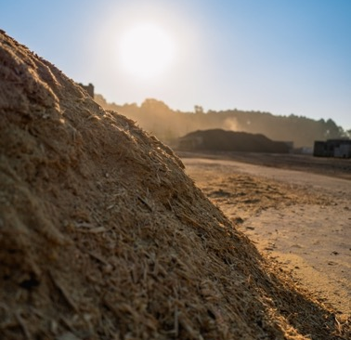
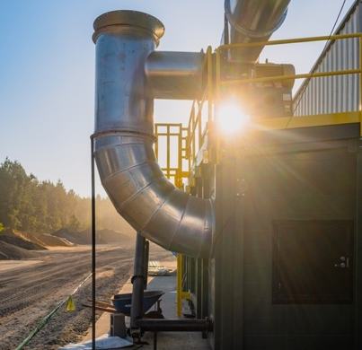
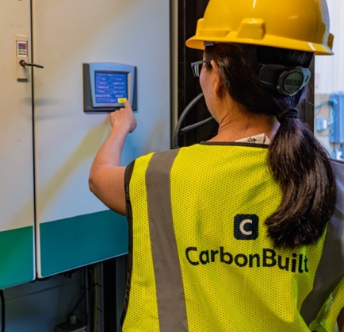
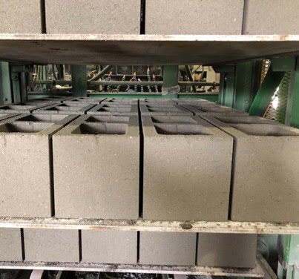
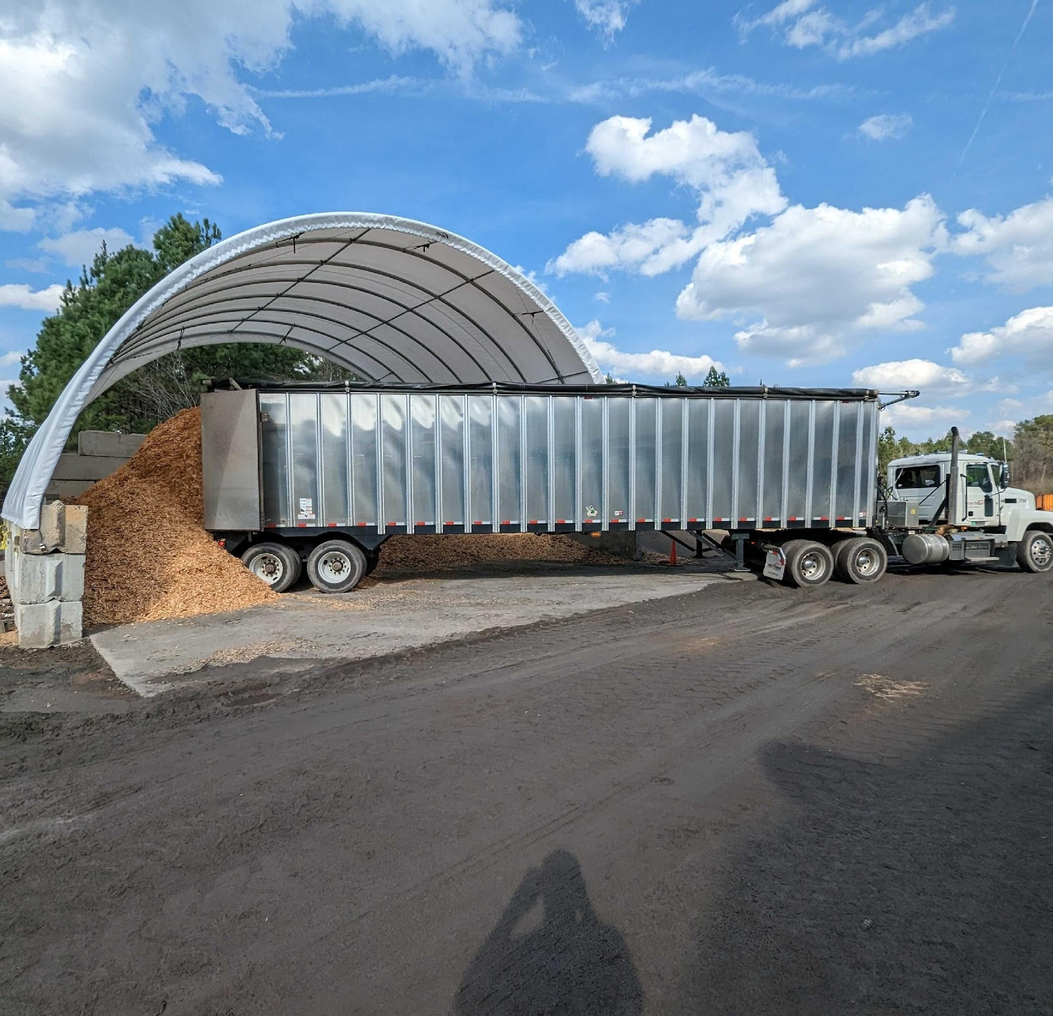
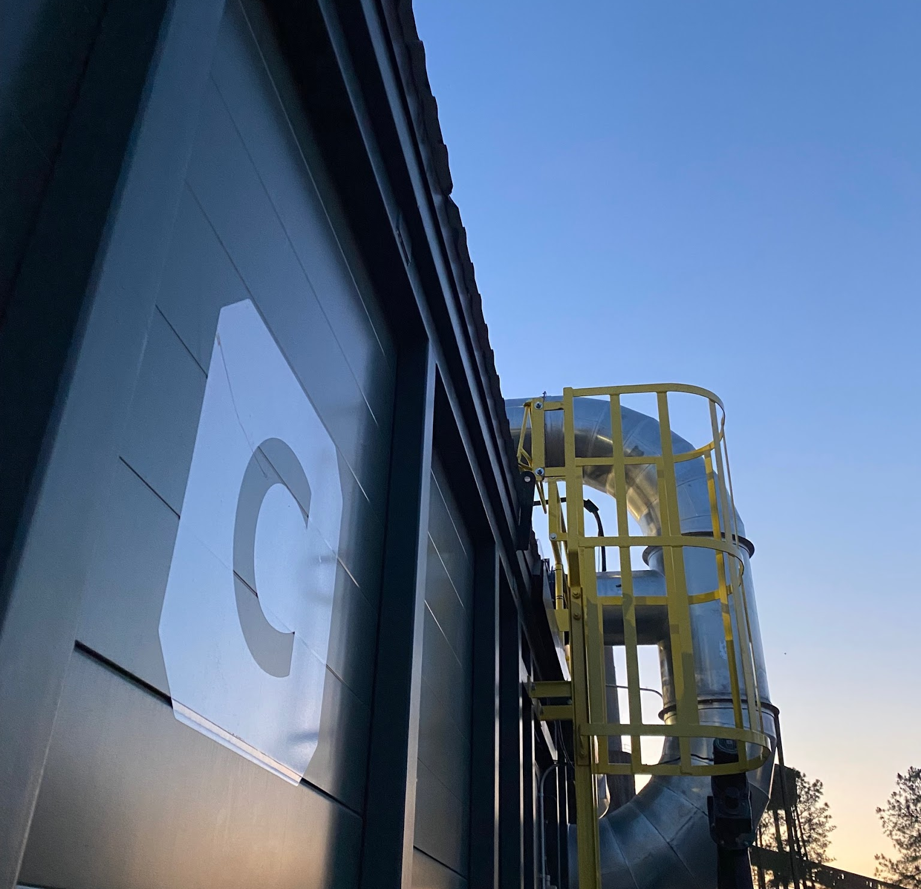
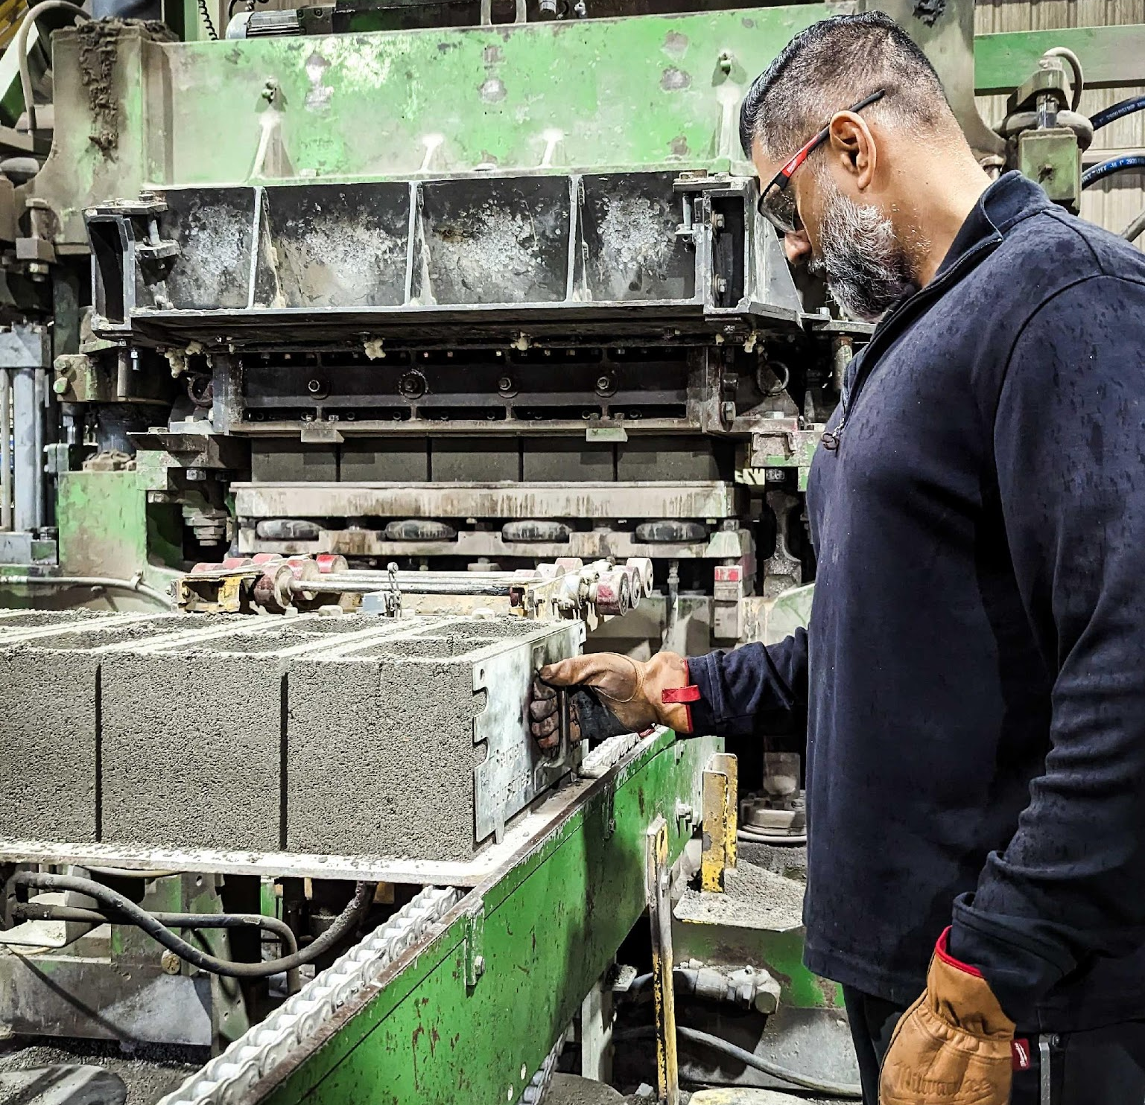
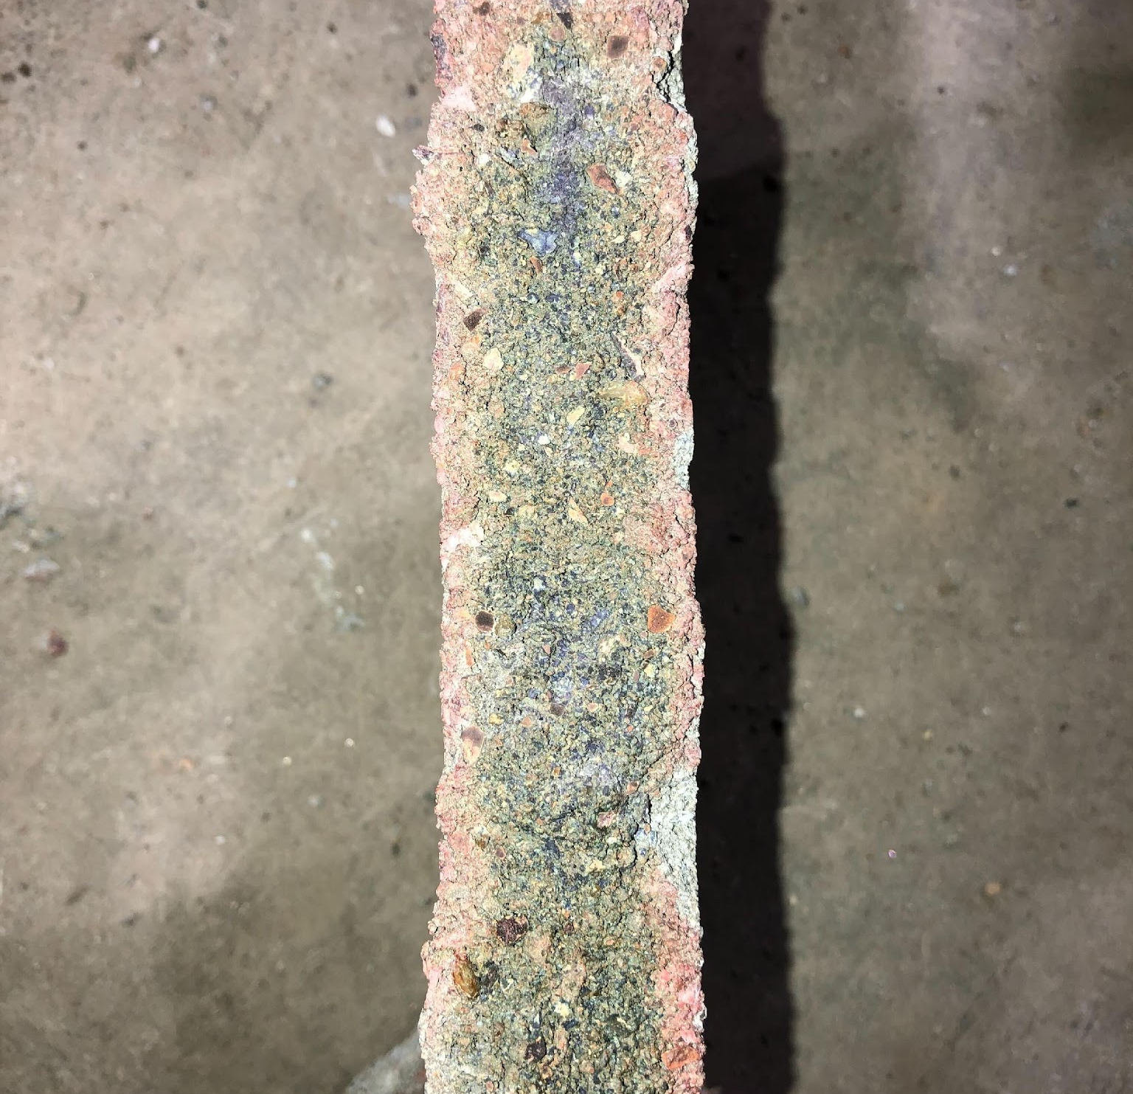
CarbonBuilt’s first producer partner is Blair Block, near Birmingham, AL
“
"It’s a win-win for our company. Reducing or eliminating cement is better for the environment, and it increases our profitability."
Matt Blair, Owner
Building a Better Future Using Carbon for Good
Notes:
Signed a contract in April
Major equipment arrived btwn Jul & Oct
Finished construction in December
Wrapping up commissioning now… product availability announcement coming soon.

Slide 11
CarbonBuilt’s first producer partner is Blair Block, near Birmingham, AL
0.139
0.034
75% Reduction
(0.007)
104% Reduction
Building a Better Future Using Carbon for Good
Notes:
Carbon reductions at our first plant are expected to be in line with the technology’s capabilities. This chart illustrates the projected carbon reduction from two specific mixes we’ve trialed onsite.
I anticipate that we’ll be starting which looks like Mix 1 as we work through our first months of production and get a full sense for the impact of variability in materials, weather, etc.
Once we have some operating history we can start being a bit more aggressive about pushing more cement out of the product, for at least some product variants, to push us closer to the carbon reduction shown on the bottom.
Equally excited about the economics –2 year payback.
We’re excited about commercial launch, but also about the demand we’re seeing from our customer pipeline.
In parallel to getting our first retrofit designed, built and commissioned we’ve been out engaging with the masonry industry across the US.
Happy to say that we have feasibility studies underway with producers who operate more than a quarter of the plants in the country, including the country’s largest producers and numerous regional leaders.
We envision providing a full suite of services to these customers, ranging from mix design development and optimization to retrofit design and equipment supply to carbon credit monetization. We’ll have financing solutions available to facilitate retrofits and access government incentives that make the economics even better – really the whole package of services required to unlock the full economic potential of the technology to drive rapid adoption.

Slide 12
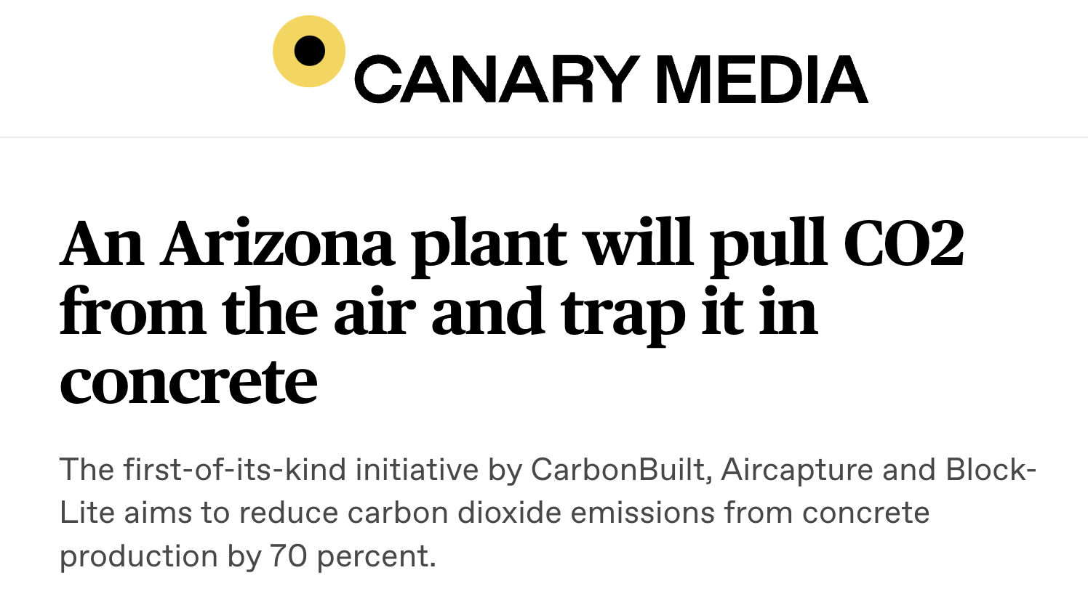
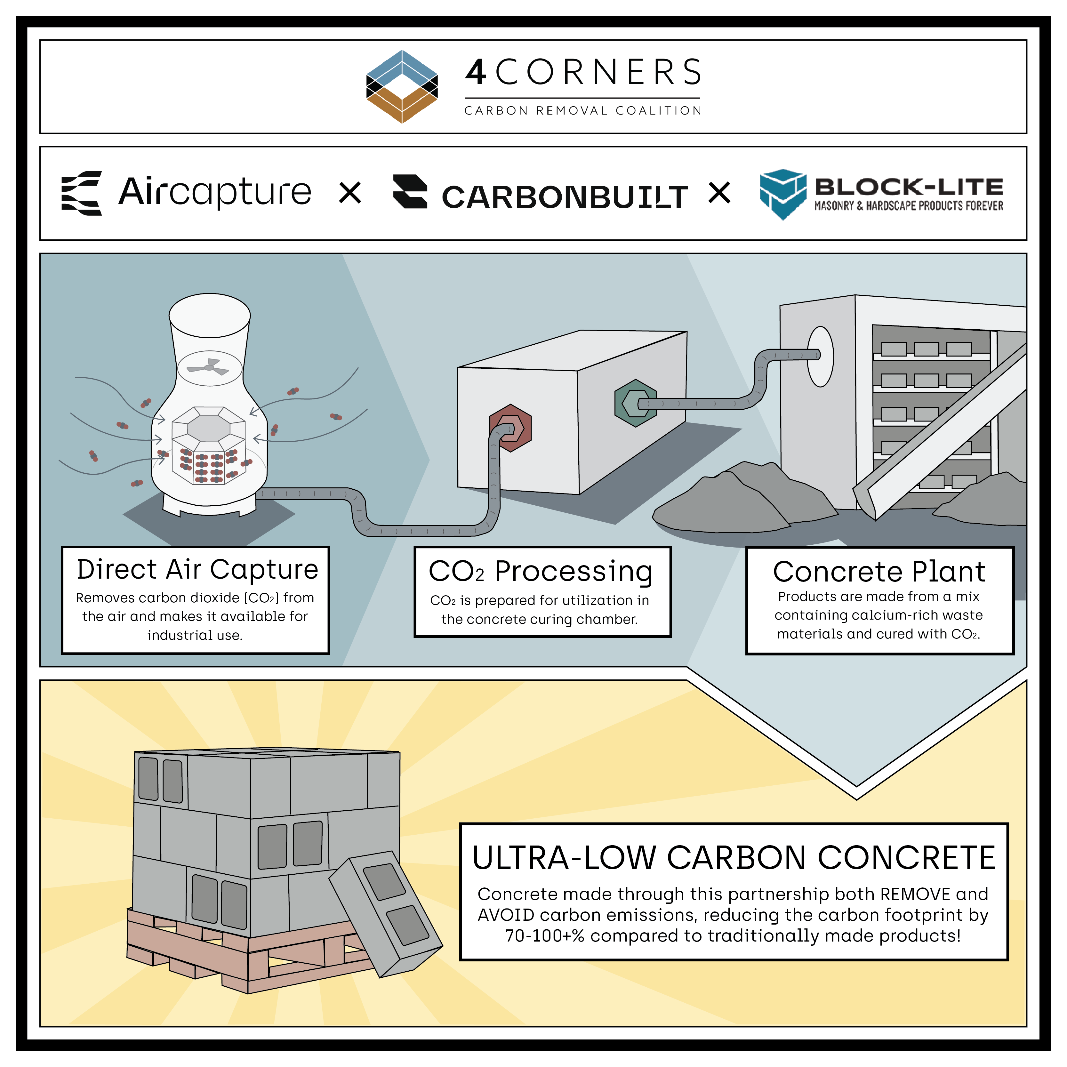
World’s First Integrated DAC-to-Concrete Plant
Creates a practical pathway to drive down the cost of DAC by deploying it alongside CarbonBuilt
Enabled by premium carbon removal credit purchase
Anticipated product availability: 2024
Notes:
This platform will also enable

Slide 13

Vision
A world in which global economic prosperity is no longer a threat to the climate
Mission
To enable concrete manufacturing to drive large-scale greenhouse gas emissions reductions through the cost-effective utilization of CO₂ and industrial waste
Rahul Shendure, CEO
206-999-5373
rshendure@carbonbuilt.com
www.carbonbuilt.com
Notes:
Encourage you to think out of the box when it comes to decarbonization, esp considering the challenges associated with CCS… facilitating and enabling decarbonization at different points in your value chain – whether that’s through investment in startups or in projects at your sites or your customer sites, supply of waste materials, product offtake, purchase of credits, etc. these might be the fastest way to start making progress in parallel to working on CCS at your plants.

Slide 14

1,500,000,000 blocks are made each year in the US
,
What if we applied CarbonBuilt technology to every US block?
We’d remove 500,000 tons of carbon from the atmosphere
And avoid putting another 2,500,000 tons up there

