Slide 1
Toward a future energy system: addressing the decarbonization challenge
Peter F. Green
Deputy Laboratory Director, Science and Technology
Chief Research Officer
National Renewable Energy Laboratory
March 29, 2023

Slide 2
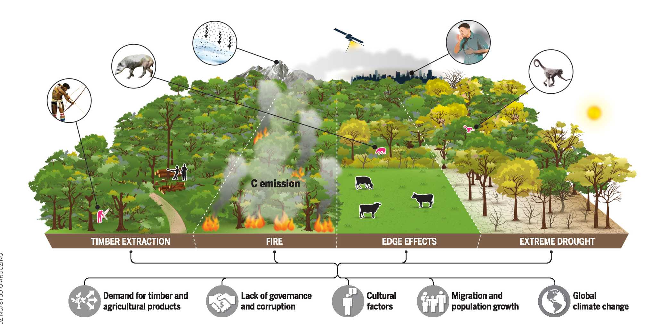
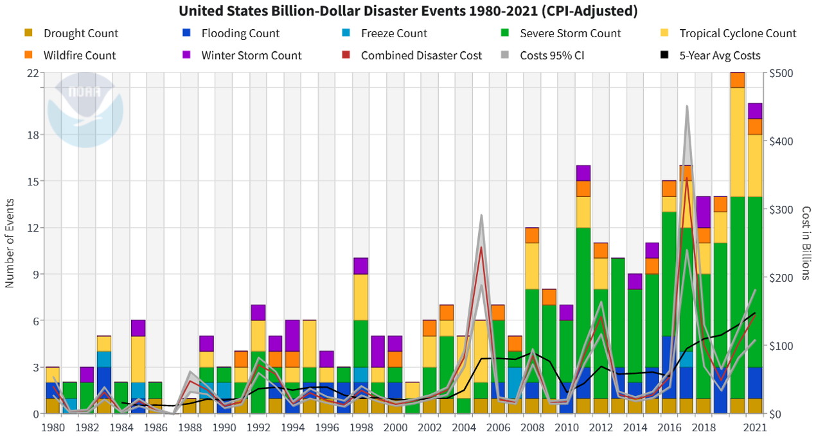

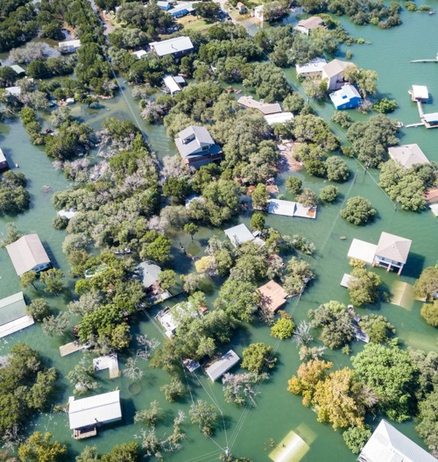
We exist in a very different world than we did at the tail end of the industrial revolution
Forest Degradation Processes in the Amazon
Billion-dollar disaster events in the US
(National Center for Environmental Information, 2022
Science, January 2023
time
Extreme
Weather Events
What steps should be taken to ensure a viable future for the US and the rest of the world?
Pollution
Notes:
2.6 million square kilometers degraded: forest fires, selective logging, extreme drought, edge effects
-

Slide 3
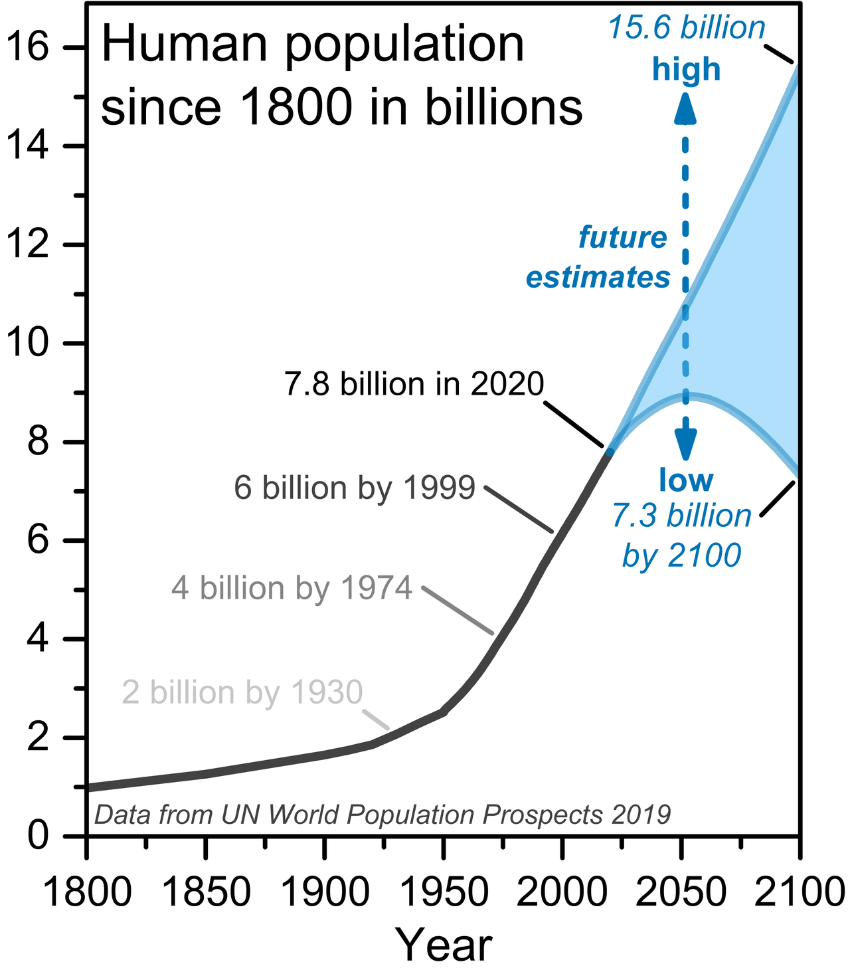

The challenge is associated with the rapid increase of the global population and of energy use, since 1900
Energy-related CO₂ emissions by sector (US)
billion metric tons
Since 1900 the global population increased by over a factor of approximately 5
Primary energy consumption increased from 7.1 TW-h/person to 22 TW-h/person, since 1900

Slide 4
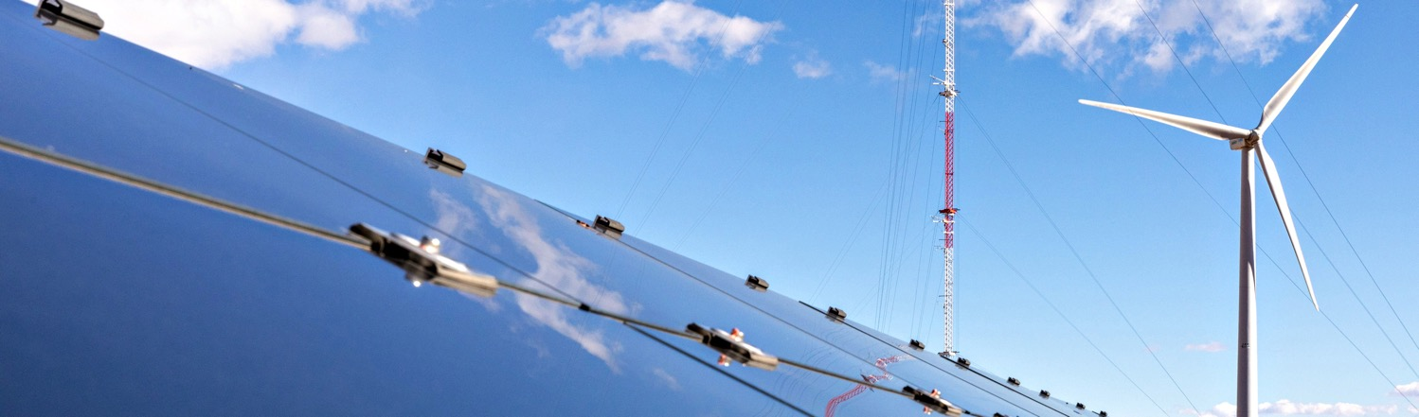




NREL Science
Drives Innovation
Workforce 3400
1000 Partnerships (industry Academia Govts.)
3 campuses
Renewable
Power
Sustainable Transportation
Energy
Efficiency
Energy Systems
Integration
Solar
Wind
Water
Geothermal
Bioenergy
Hydrogen and Fuel Cells
Transportation and Mobility
Advanced Manufacturing
Buildings
State, Local, and Tribal Governments
Energy Security and Resilience
Grid Modernization
Integrated Energy Solutions
Photo by Andrew Simms, NREL 73714
Notes:
Our research in these four main energy sectors boosts economic growth and drives the bigger engine of U. S. innovation:
Renewable Power includes solar, wind, water, and geothermal energy technologies.
Sustainable Transportation includes bioenergy, vehicle, and hydrogen technologies.
Energy Efficiency includes building technologies, advanced manufacturing research, and energy management programs.
Energy Systems Integration applies high-performance computing and data/visualization capabilities to grid modernization.

Slide 5
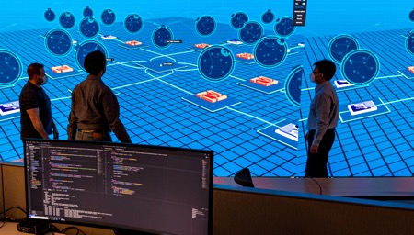


Addressing the Challenge: NREL’s Three Critical Objectives
Integrated Energy
Pathways
Electrons to
Molecules
Circular Economy for
Energy Materials
  Develop the foundational knowledge and technologies to optimize the integration of renewables, buildings, industry, energy storage, and transportation—modernizing our energy systems and ensuring a secure and resilient grid.
The conversion of electricity and small waste gases (e.g., CO₂, H₂O, N₂) into chemical bonds for the purposes of chemical, material, or fuel synthesis and/or energy storage.
Establishing the foundational knowledge/technology for design, recycle, reuse, remanufacture, and reliability for energy-relevant materials and processes.

Slide 6

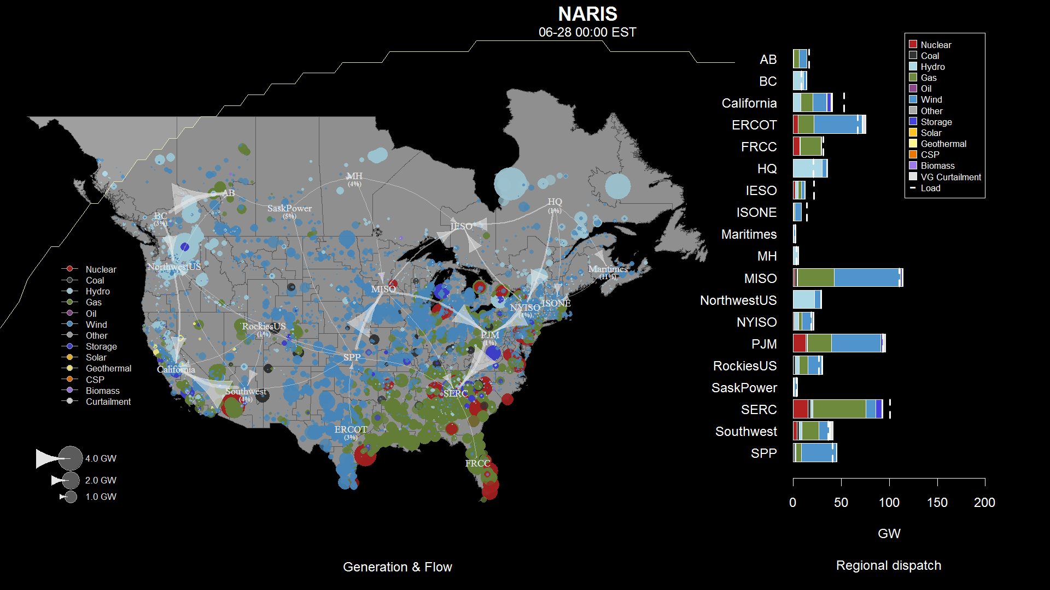
The North American Grid with High Amounts of Renewables in 2050
Western Interconnect
Eastern Interconnect
This slide shows a day in the life of the future grid with large amounts of wind and solar.
Info from the North American Renewable Integration Study (NARIS)

Slide 7
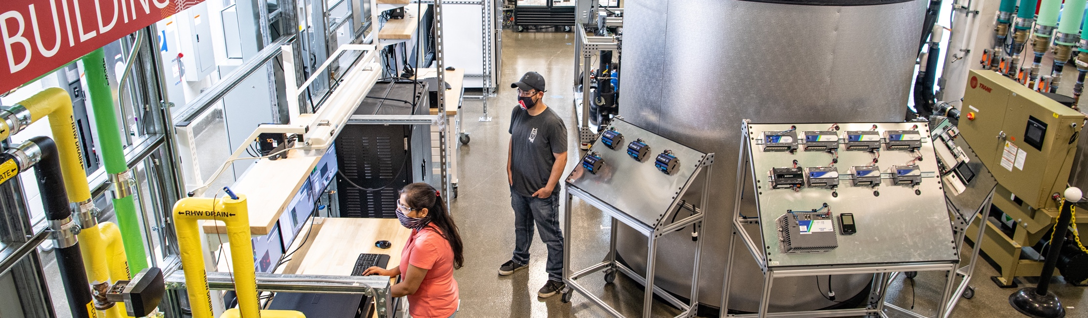


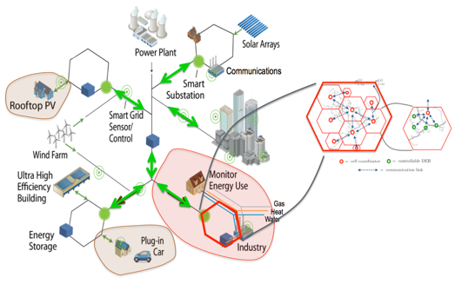
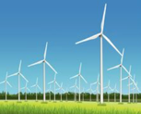

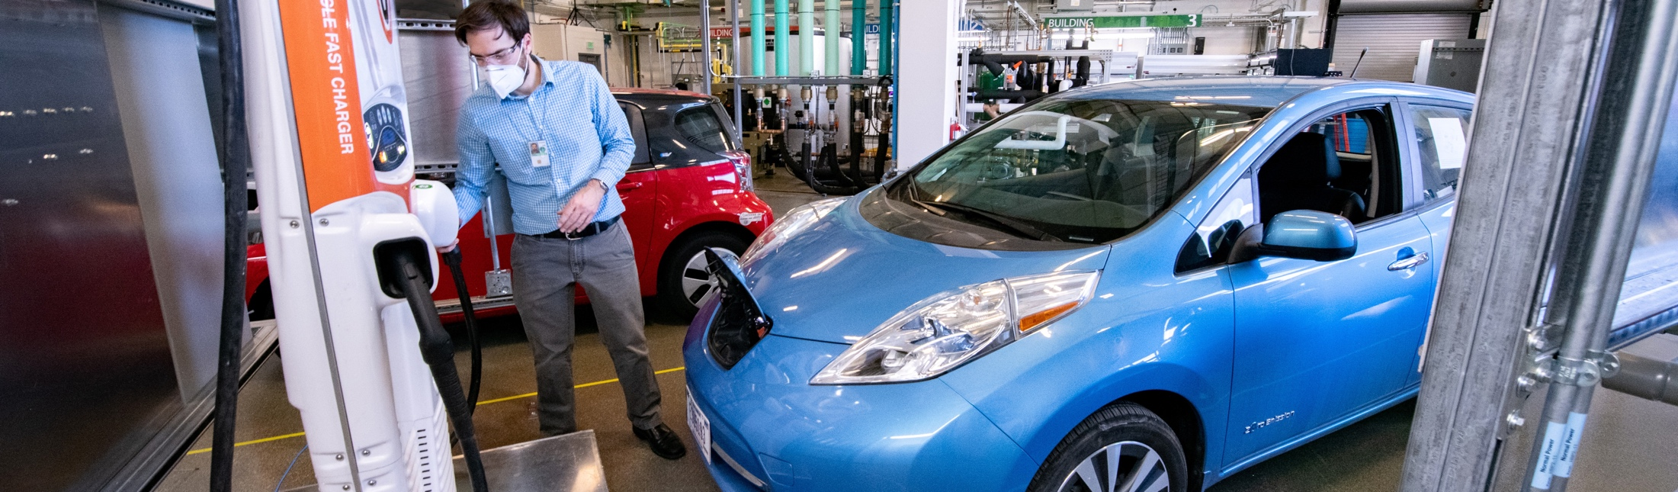
Energy system of the future and Decarbonization
Diverse power generation sources (inverter-based grid) -High penetrations of wind and solar
Electrification –transportation, industry
  Grid interactive buildings/communities
  Different Storage technologies (time scales)
  Mobility…connectivity
Autonomous control of millions of devices
  storage, distributed energy resources, smart appliances, EVs…
Cyber and physical security, reliability, resilience
Low carbon fuels: marine, rail, air
    Hydrogen infrastructure
    Carbon Capture, Storage
    CO₂ conversion: Chemicals, materials, fuels
Notes:
-short hours and long (seasonal)

