Slide 1
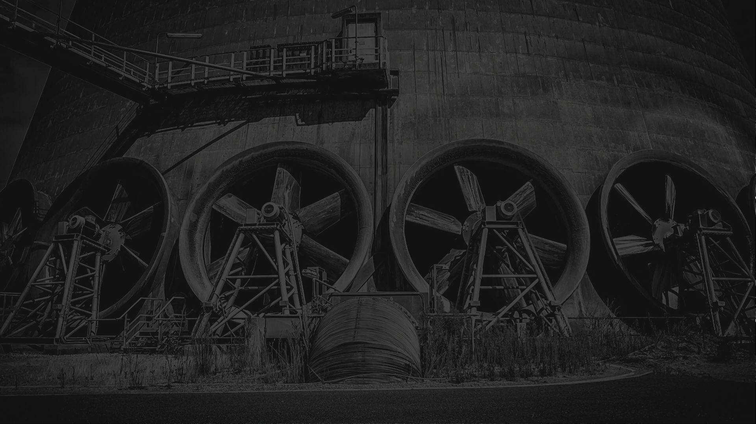


Offsetting Decarb Connect Europe 2022
Carbon Neutrality Partner:

Slide 2

Our Mission
Decarb Connect supports decarbonization leaders in the most energy-intensive sectors – those with complex challenges to solve. Our global platform combines a unique membership network (industry only) with an open-access summit series, reports, podcasts and more.
We broker access to hard-to-reach information and facilitate collaborations – all with the goal of accelerating decarbonisation in the hardest-to-abate sectors.
Decarb Connect Europe is part of our event series and this year, for the first time ever, took place in-person in Amsterdam, Netherlands from June 21st – 23rd, 2022.
WWW.DECARBCONNECT.COM

Slide 3

Carbon Neutral Partnership
Decarb Connect – brings together stakeholders in the toughest-to-abate sectors to rise to the net-zero challenge
ClearBlue Markets – works towards global decarbonization with companies across industries, mobilizing multiple strategies in the carbon toolkit, including participation in compliance and voluntary carbon markets
ClearBlue Markets has become Decarb Connect’s Carbon Neutrality Partner in our continued efforts to support and decarbonize hard-to-abate sectors
In this report we shed light on the offsetting policy for Decarb Connect Europe 2022
WWW.DECARBCONNECT.COM

Slide 4



Step 1: Measure Activity Emissions
The first step towards offsetting carbon emissions is measuring the tonnes of CO₂ the conference activities emitted. For in-person events like Decarb Connect Europe, this depends on factors such as attendee travel, waste and venue energy consumption.
Travel – These emissions are determined by noting where attendees have travelled in from and modes of transport used
Waste – These emissions depend on the materials and food thrown away
Energy – These emissions are calculated based on the size of the venue and the activities conducted
WWW.DECARBCONNECT.COM

Slide 5
Step 2: Calculate Footprint
Once the emissions for each activity have been established, we can calculate the overall footprint of the conference. ClearBlue Markets determined Decarb Connect Europe to require 0.27 tonnes of CO₂ per participant. Overall, the event produced 52.70 tonnes of CO₂.
Travel – Emissions factors for bike, car, train and airplane were applied to determine how much CO₂ each attendee produced during travel. These were then added together to establish the overall emissions for attendee travel
Waste – We engaged with our supply chain to determine how much waste was produced
Energy – Regional grid factors were applied to determine the amount of CO₂ emitted to produce this energy in Amsterdam
WWW.DECARBCONNECT.COM

Slide 6

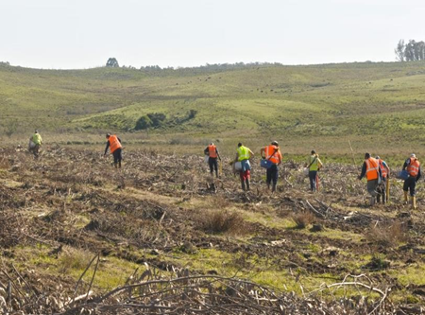


Step 3: Offset
Decarb Connect Europe 2022 has become carbon positive through the retirement of credits in Gold Standard Project 959 – Afforestation Project in Uruguay
ClearBlue Markets and Decarb Connect are contributing to the construction of forest plantations
The project is certified to contribute to SDG1 (No Poverty), SDG8 (Decent Work and Economic Growth) and SDG15 (Life on Land). The project is expected to remove the equivalent emissions of taking 1.65 million cars off the road for 1 year
Supporting this project will help with the sequestration of CO2 from the atmosphere and provide high-value, long-lived timber
WWW.DECARBCONNECT.COM

Slide 7
Step 3: Offset
With approximately 190 participants from a total of 21 countries, the total emissions from Decarb Connect Europe 2022 is 52.70 tonnes of CO₂
In-person conferences are estimated to produce 0.5 tonnes of CO₂ per participant. Decarb Connect Europe 2022 participants emitted 44% less than the estimated average
These emissions can be used as a baseline for carbon reduction strategies for future Decarb Connect Europe events
WWW.DECARBCONNECT.COM

Slide 8
Step 4: Comparing DCEU22 to DCNA22
Decarb Connect Europe 2022 participants used greener modes of transport, like bikes, trains or metros, which have lower carbon footprints compared to flying or driving
Energy use was higher for Decarb Connect Europe 2022 compared to Decarb Connect North America 2022 due to the Netherlands’ grid factors, more space being used, and more hotel stays as a result of more participants
10% of lanyards were collected at the end of Decarb Connect North America 2022 and Decarb Connect Europe 2022 to be reused at future Decarb Connect events
WWW.DECARBCONNECT.COM

Slide 9



Step 5: Reflect
Decarb Connect Europe 2022 emitted 44% less CO₂ per participant than in-person event estimations and Decarb Connect North America 2022
We improved our data collection by engaging more with our supply chain and we were able to track the amount of waste produced during the event. This will allow us to set targets and implement ways to reduce our waste at future events
The materials purchased for the event, like banners, lanyards and badges, were recyclable and reusable to reduce waste. We aim to track how much we reuse for future events
WWW.DECARBCONNECT.COM

Slide 10

About Decarb Connect
“
Decarb Connect focus on hard-to-abate sectors including cement, steel, O&G, power & utilities, ceramics and more. Their events and reports support those leading the deployment of decarbonization plans including heads of corporate strategy, innovation/R&D, carbon management, project directors, CTOs, COOs and finance leaders. Decarb Connect works with industry to set an annual agenda for essential research, benchmarking data, live events, retreats and more.
If you’re selecting technologies, establishing high performing collaborations, initiating pilots or working out how to scale innovative projects – each element of the Decarb Connect offering helps you solve the systemic and technical barriers to decarbonization.
All of the biggest heaving emitting sectors are in this audience. People who have huge influence in their organisations to drive the change that we need see in the next decade
Dexter Galvin, Global Director, Corporations & Supply Chains, CDP
Membership of the Decarbonization Leaders Network brings the opportunity to meet with peers and cross-sector allies from across the energy-intensive sectors. By learning with your peers, including sharing your own successes, creating a network that can jointly progress – speeding up decisions and making robust choices that will accelerate decarbonization. Find out more >>
Events, webinars
& networking
Each event – whether digital or in-person – is constructed in consultation with the Decarbonization Leaders network and the wide community to balance your need for information and benchmarking. View upcoming events >>
Find out more by visiting: www.decarbconnect.com
E: hello@decarbconnect.com
Industry insights, reports and podcast
It’s Decarb Connect’s mission to accelerate industrial decarbonization by bringing you regular insight, articles, interviews and podcasts from those who share our vision. Read more >>

Slide 11






About ClearBlue Markets
How ClearBlue’s services work together
Carbon Market Trading
Offset Development & Asset Management
Carbon Strategy Advisory
Technology & Data
Our Expertise is in “All Things Carbon”
Advisory
Carbon Market Compliance
Policy and Regulations
Offsets
Capacity Building
Risk Management
Position Management & Strategy
Sales
Origination
Advocacy
Project Development
Market Research
ClearBlue is an award-winning company specializing in carbon pricing advisory, market analysis, transactions, and offset development
Our services work together to create comprehensive carbon markets strategies and solutions for current and prospective
ClearBlue clients

